Slide 1


Noida Institute of Engineering and Technology, Greater Noida
Subject: Mathematics-III
Subject Code: AAS0301A
Unit: I
Complex Variable-Differentiation
Dr. Kunti Mishra
Department of
Mathematics
B Tech 3rd Sem

Slide 2
Sequence of contents
1 | Name of Subject with code, Course and Subject Teacher
2 | Brief Introduction of Faculty member with Photograph
3 | Evaluation Scheme
4 | Subject Syllabus
5 | Branch wise Applications
6 | Course Objective (Point wise)
7 | Course Outcomes (COs)
8 | Program Outcomes only heading (POs)
9 | COs and POs Mapping

Slide 3
Sequence of contents
10 | Program Specific Outcomes (PSOs)
11 | COs and PSOs Mapping
12 | Program Educational Objectives (PEOs)
13 | Result Analysis (Department Result, Subject Result and Individual Faculty Result)
14 | End Semester Question Paper Templates (Offline Pattern/Online Pattern)
15 | Prequisite/ Recap
16 | Brief Introduction about the Subject with videos
17 | Unit Content
18 | Unit Objective
19 | Topic Objective/Topic Outcome

Slide 4
Sequence of contents
20 | Lecture related to topic
21 | Daily Quiz
22 | Weekly Assignment
23 | Topic Links
24 | MCQ (End of Unit)
25 | Glossary Questions
26 | Old Question Papers (Sessional + University)
27 | Expected Questions
28 | Recap of Unit

Slide 5
Brief Introduction of Faculty
Dr. Kunti Mishra
Assistant Professor
Department of Mathematics
Qualifications:
M.Sc.(Maths), M. Tech.(Gold Medalist) in Applied and Computational Mathematics, Ph.D
Ph.D. Thesis: Some Investigations in Fractal Theory
International Journal Publications: 7
International Conference Papers: 7
Area of Interests: Fixed Point Theory, Fractals
Teaching Experience: 5 years

Slide 6
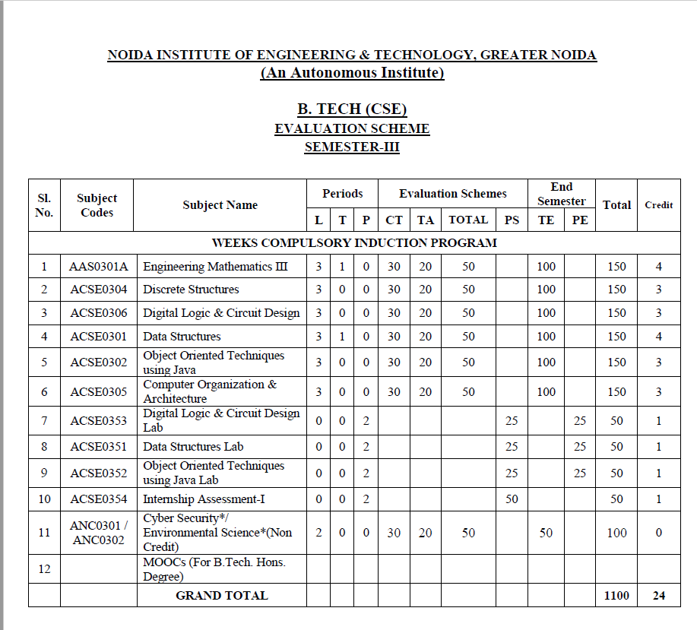
Evaluation Scheme

Slide 7

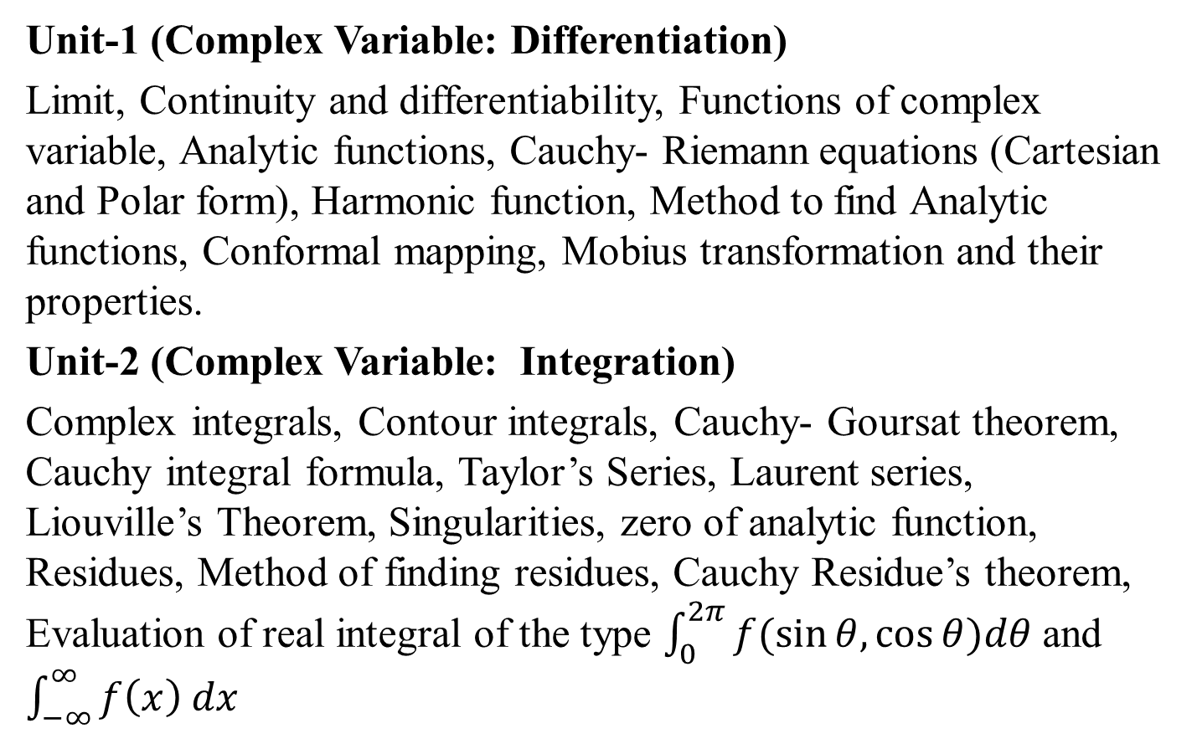
Syllabus
Unit-1 (Complex Variable: Differentiation)
Limit, Continuity and differentiability, Functions of complex variable, Analytic functions, Cauchy- Riemann equations (Cartesian and Polar form), Harmonic function, Method to find Analytic functions, Conformal mapping, Mobius transformation and their properties.
Unit-2 (Complex Variable: Integration)
Complex integrals, Contour integrals, Cauchy- Goursat theorem, Cauchy integral formula, Taylor’s Series, Laurent series, Liouville’s Theorem, Singularities, zero of analytic function, Residues, Method of finding residues, Cauchy Residue’s theorem, Evaluation of real integral of the type $\int_{0}^{2π}{f(\sin{θ,\cos{θ)dθ}}}$ and $\int_{−∞}^{∞}{f\left(x\right) dx}$

Slide 8
Syllabus
Unit-3 (Partial Differential Equation and its Applications)
Introduction of partial differential equations, Second order linear partial differential equations with constant coefficients. Classification of second order partial differential equations, Method of separation of variables for solving partial differential equations, Solution of one and two dimensional wave and heat conduction equations.

Slide 9
Syllabus
Unit-4 (Numerical Techniques)
Error analysis, Zeroes of transcendental and polynomial equations using Bisection method, Regula-falsi method and Newton-Raphson method, Interpolation: Finite differences, Newton’s forward and backward interpolation, Lagrange’s and Newton’s divided difference formula for unequal intervals. Solution of system of linear equations, Crout’s method, Gauss- Seidel method. Numerical integration: Trapezoidal rule, Simpson’s one third and three-eight rules, Solution of 1st order ordinary differential equations by fourth-order Runge- Kutta methods.
Unit-5 (Aptitude-III)
Time & Work, Pipe & Cistern, Time, Speed & Distance, Boat & Stream, Sitting Arrangement, Clock & Calendar.

Slide 10
Branch Wise Applications
Concept of Complex variable is used in speech recognition, image processing etc.
Function of complex variable helps in evaluation of area, which is required in many physical formulation.

Slide 11
Course Objective
The objective of this course is to familiarize the engineers with concept of function of complex variables, complex variables& their applications, Integral Transforms for various mathematical tasks and numerical aptitude. It aims to show case the students with standard concepts and tools from B. Tech to deal with advanced level of mathematics and applications that would be essential for their disciplines. The students will learn:
The idea of function of complex variables and analytic functions.
The idea of concepts of complex functions for evaluation of definite integrals
The concepts of concept of partial differential equation to solve partial differential and its applications.

Slide 12
Course Objective
The concept of finding roots by numerical method, interpolation and numerical methods for system of linear equations, definite integral and 1st order ordinary differential equations.
The concept of problems based on Time & Work, Pipe & Cistern, Time, Speed & Distance, Boat & Stream, Sitting Arrangement, Clock & Calendar.

Slide 13
Course Outcome
CO1: Apply the working methods of complex functions for finding analytic functions.
CO2: Apply the concepts of complex functions for finding Taylor’s series, Laurent’s series and evaluation of definite integrals.
CO3: Apply the concept of partial differential equation to solve complex variables and problems concerned with partial differential equations

Slide 14
Course Outcome
CO4: Apply the concept of numerical techniques to evaluate the zeroes of the Equation, concept of interpolation and numerical methods for various mathematical operations and tasks, such as integration, the solution of linear system of equations and the solution of differential equation.
CO5: Solve the problems of Time & Work, Pipe & Cistern, Time, Speed & Distance, Boat & Stream, Sitting Arrangement , Clock & Calendar.

Slide 15
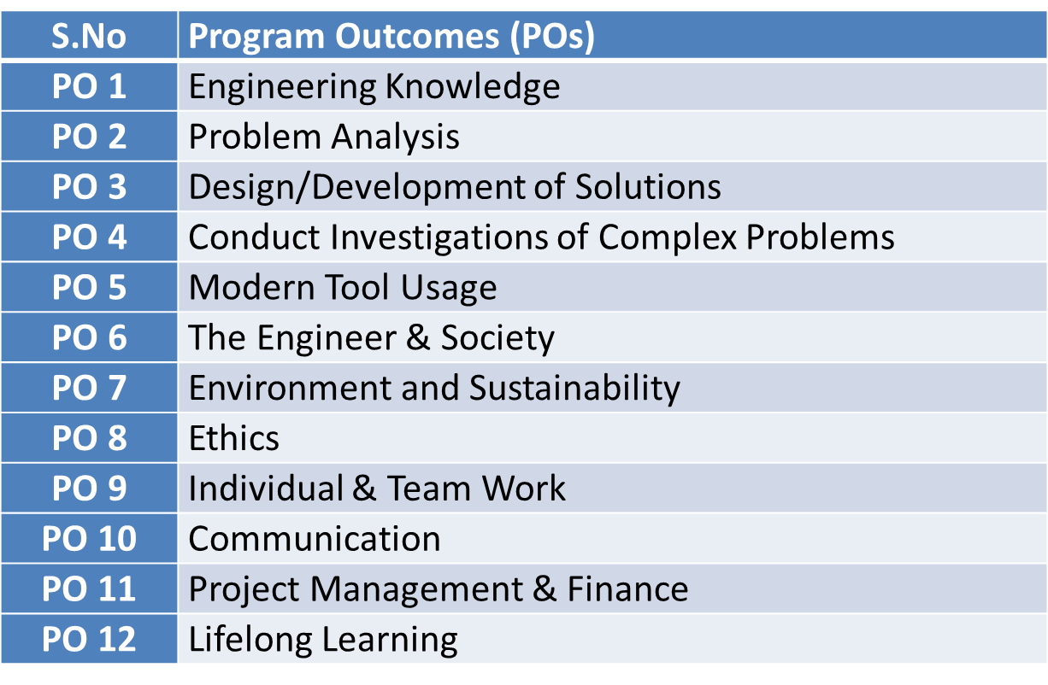
Program Outcomes

Slide 16
CO-PO Mapping(CO1)
Sr. No | Course Outcome | PO1 | PO2 | PO3 | PO4 | PO5 | PO6 | PO7 | PO8 | PO9 | PO10 | PO11 | PO12
1 | CO 1 | H | H | H | H | L | L | L | L | L | L | L | M
2 | CO 2 | H | H | H | H | L | L | L | L | L | L | M | M
3 | CO 3 | H | H | H | H | L | L | L | L | L | L | M | M
4 | CO 4 | H | H | H | H | L | L | L | L | L | L | L | M
5 | CO 5 | H | H | H | H | L | L | L | L | L | L | M | M
*L= Low *M= Medium *H= High

Slide 17
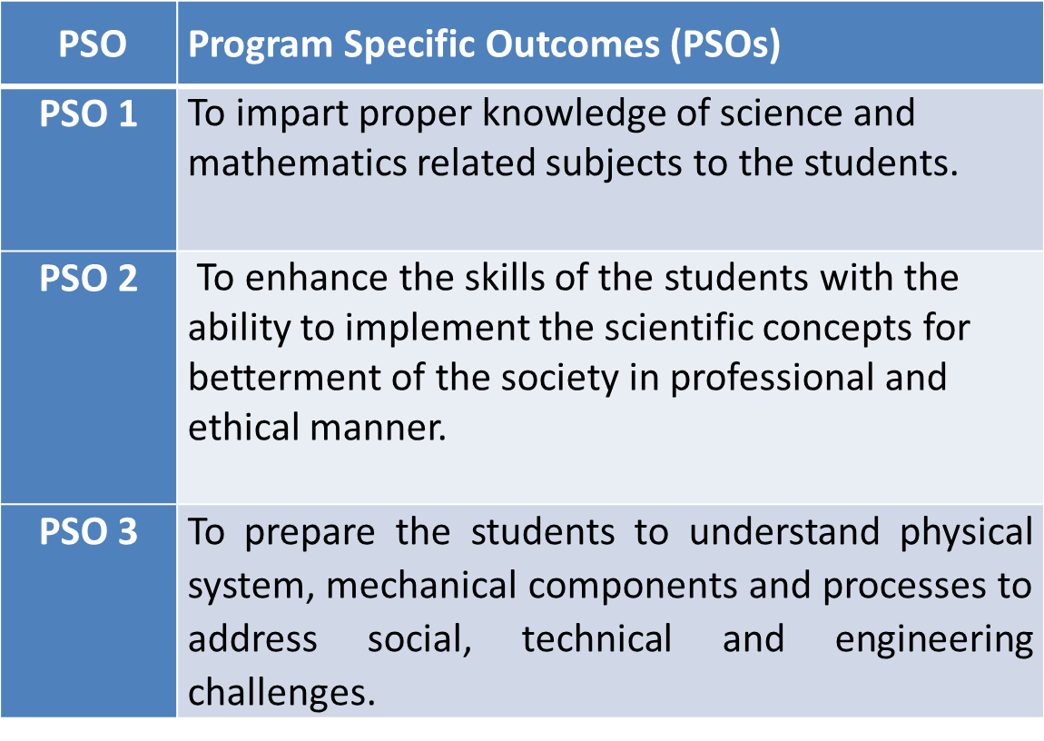
PSO

Slide 18
CO-PSO Mapping(CO1)
*L= Low *M= Medium *H= High
CO | PSO 1 | PSO 2 | PSO 3
CO.1 | H | L | M
CO.2 | L | M | L
CO.3 | M | M | M
CO.4 | H | M | M
CO.5 | H | M | M

Slide 19
Program Educational Objectives(PEOs)
PEO-1: To have an excellent scientific and engineering breadth so as to comprehend, analyze, design and provide sustainable solutions for real-life problems using state-of-the-art technologies.
PEO-2: To have a successful career in industries, to pursue higher studies or to support entrepreneurial endeavors and to face the global challenges.
PEO-3: To have an effective communication skills, professional attitude, ethical values and a desire to learn specific knowledge in emerging trends, technologies for research, innovation and product development and contribution to society.
PEO-4: To have life-long learning for up-skilling and re-skilling for successful professional career as engineer, scientist, entrepreneur and bureaucrat for betterment of society.

Slide 20
Result Analysis
Name of Faculty | Dr. Kunti Mishra
Branch | CS
No. of Students | 67
No. of Passed students | 67
Result Percentage | 100%
Branch | IT
No. of Students | 68
No. of Passed students | 68
Result Percentage | 100%

Slide 21
End Semester Question Paper Template
100 Marks Question Paper Template.docx

Slide 22
Prerequisite and Recap(CO1)
Knowledge of differentiation
Knowledge of real valued function

Slide 23
Brief Introduction about the subject with videos
We will discuss properties of complex function ( limits, continuity, differentiability, Analyticity and integration)
In 3rd module we will discuss application of partial differential equations
In 4th module we will discuss numerical methods for solving algebraic equations, system of linear equations, definite integral and 1st order ordinary differential equation.
In 5th module we will discuss aptitude part.
https://youtu.be/iUhwCfz18os
https://youtu.be/ly4S0oi3Yz8
https://youtu.be/f8XzF9_2ijs

Slide 24
Unit Content
Limit, Continuity and differentiability
Functions of complex variable,
Analytic functions
Cauchy- Riemann equations (Cartesian and Polar form),
Harmonic function
Method to find Analytic functions
Conformal mapping
Mobius transformation and their properties.

Slide 25
Unit Objective(CO1)
The objective of this course is to familiarize the engineers with concept of function of complex variables. It aims to show case the students with standard concepts and tools from B. Tech to deal with advanced level of mathematics and applications that would be essential for their disciplines.

Slide 26
Topic Objective(CO1)
Gain some basic knowledge of complex numbers, complex plane, region in complex plane.

Slide 27
Complex variables (CO1)
Complex Variables

Slide 28
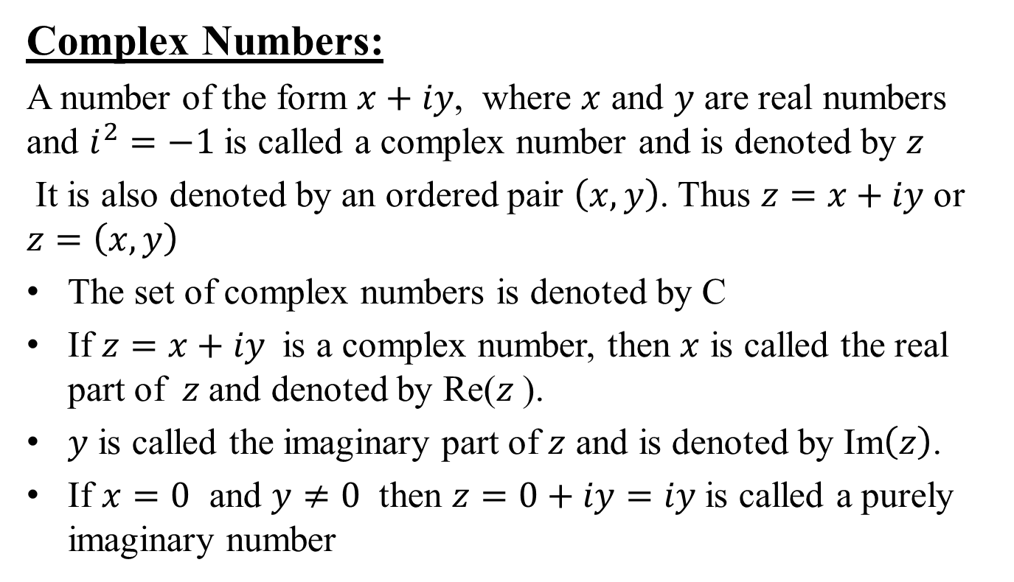
Complex variables (CO1)
Complex Numbers:
A number of the form $x+iy$, where $x$ and $y$ are real numbers and $i^{2}=−1$ is called a complex number and is denoted by $z$
It is also denoted by an ordered pair $\left(x,y\right)$. Thus $z=x+iy$ or $z=\left(x,y\right)$
The set of complex numbers is denoted by C
If $z=x+iy$ is a complex number, then $x$ is called the real part of $z$and denoted by Re($z$).
$y$ is called the imaginary part of $z$ and is denoted by Im$\left(z\right)$.
If $x=0$ and $y≠0$ then $z=0+iy=iy$ is called a purely imaginary number

Slide 29
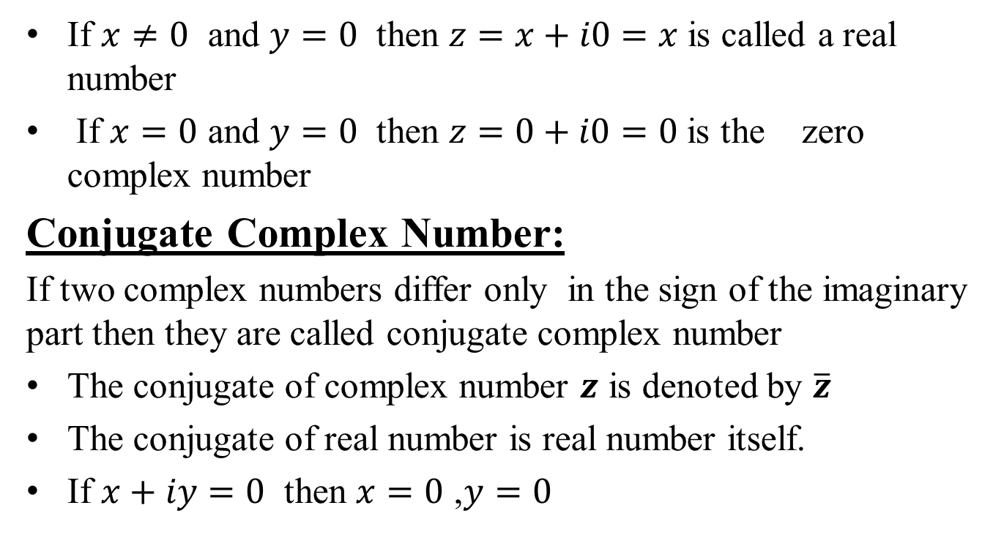
Complex variables(CO1)
If $x≠0$ and $y=0$ then $z=x+i0=x$ is called a real number
If $x=0$ and $y=0$ then $z=0+i0=0$ is the zero complex number
Conjugate Complex Number:
If two complex numbers differ only in the sign of the imaginary part then they are called conjugate complex number
The conjugate of complex number $z$ is denoted by $\overline{z}$
The conjugate of real number is real number itself.
If $x+iy=0$ then $x=0$ ,$y=0$

Slide 30
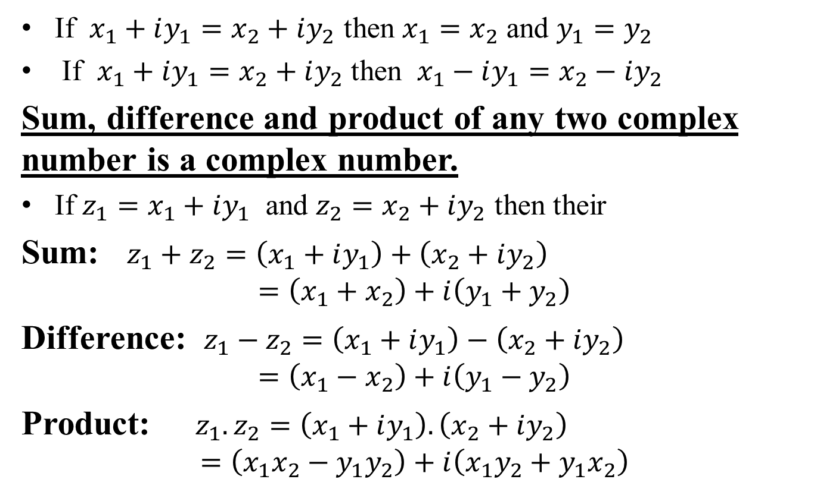
Complex variables(CO1)
If $x_{1}+iy_{1}=x_{2}+iy_{2}$ then $x_{1}=x_{2}$ and $y_{1}=y_{2}$
If $x_{1}+iy_{1}=x_{2}+iy_{2}$ then $x_{1}−iy_{1}=x_{2}−iy_{2}$
Sum, difference and product of any two complex number is a complex number.
If $z_{1}=x_{1}+iy_{1}$ and $z_{2}=x_{2}+iy_{2}$ then their
Sum: $z_{1}+z_{2}=\left(x_{1}+iy_{1}\right)+\left(x_{2}+iy_{2}\right)$
$$=\left(x_{1}+x_{2}\right)+i\left(y_{1}+y_{2}\right)$$
Difference: $z_{1}−z_{2}=\left(x_{1}+iy_{1}\right)−\left(x_{2}+iy_{2}\right)$
$$=\left(x_{1}−x_{2}\right)+i\left(y_{1}−y_{2}\right)$$
Product: $z_{1}.z_{2}=\left(x_{1}+iy_{1}\right).\left(x_{2}+iy_{2}\right)$
$$=\left(x_{1}x_{2}−y_{1}y_{2}\right)+i\left(x_{1}y_{2}+y_{1}x_{2}\right)$$

Slide 31
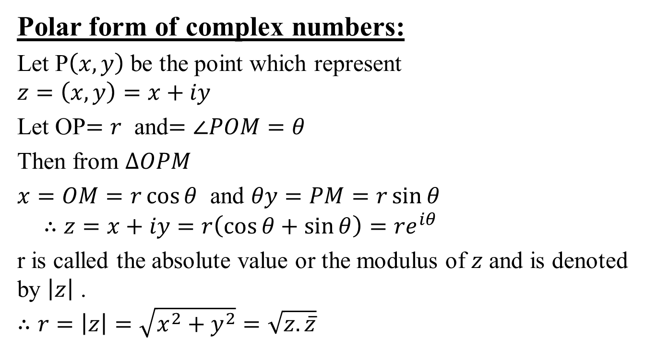
Complex variables(CO1)
Polar form of complex numbers:
Let P$\left(x,y\right)$ be the point which represent
$$z=\left(x,y\right)=x+iy$$
Let OP$=r$ and$=∠POM=θ$
Then from $∆OPM$
$x=OM=r\cos{θ}$ and $θy=PM=r\sin{θ}$
$$∴z=x+iy=r\left(\cos{θ}+\sin{θ}\right)=re^{iθ}$$
r is called the absolute value or the modulus of $z$ and is denoted by $\left|z\right|$ .
$$∴r=\left|z\right|=\sqrt{x^{2}+y^{2}}=\sqrt{z.\overline{z}}$$

Slide 32
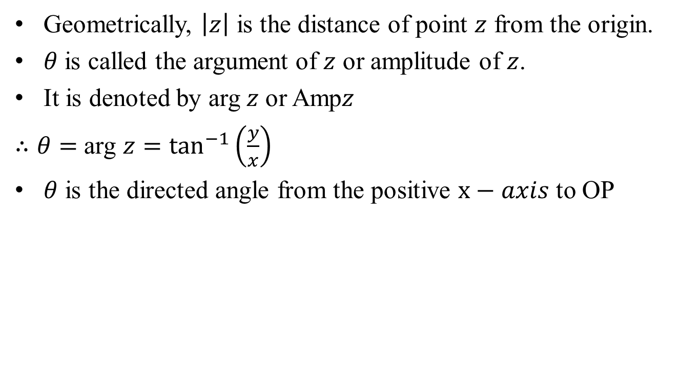
Complex variables(CO1)
Geometrically, $\left|z\right|$ is the distance of point $z$ from the origin.
$θ$is called the argument of $z$ or amplitude of $z$.
It is denoted by arg$z$ or Amp$z$
$∴θ=$ arg $z=\tan^{−1}\left(\frac{y}{x}\right)$
$θ$ is the directed angle from the positive $x−axis$ to OP

Slide 33
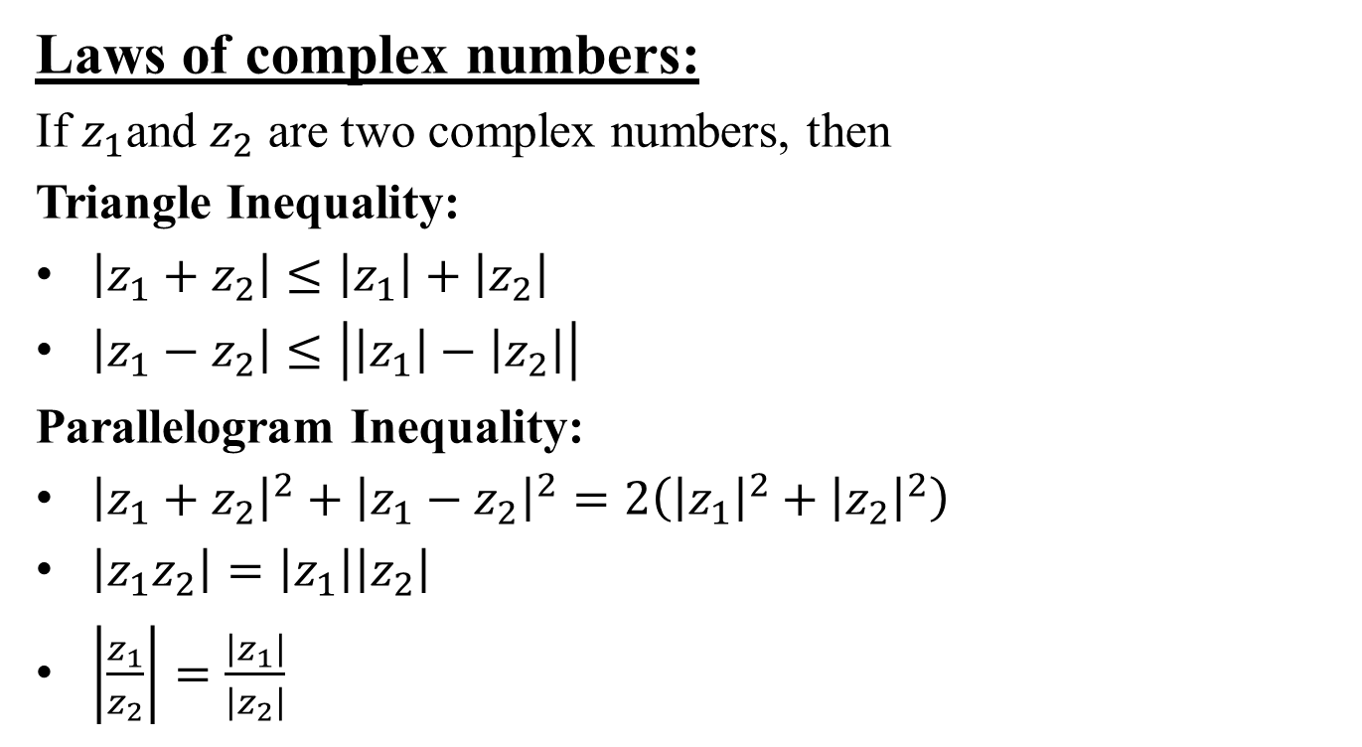
Complex variables(CO1)
Laws of complex numbers:
If $z_{1}$and $z_{2}$ are two complex numbers, then
Triangle Inequality:
$\left|z_{1}+z_{2}\right|≤\left|z_{1}\right|+\left|z_{2}\right|$
$\left|z_{1}−z_{2}\right|≤\left|\left|z_{1}\right|−\left|z_{2}\right|\right|$
Parallelogram Inequality:
${\left|z_{1}+z_{2}\right|}^{2}+{\left|z_{1}−z_{2}\right|}^{2}=2\left({\left|z_{1}\right|}^{2}+{\left|z_{2}\right|}^{2}\right)$
$\left|z_{1}z_{2}\right|=\left|z_{1}\right|\left|z_{2}\right|$
$\left|\frac{z_{1}}{z_{2}}\right|=\frac{\left|z_{1}\right|}{\left|z_{2}\right|}$

Slide 34
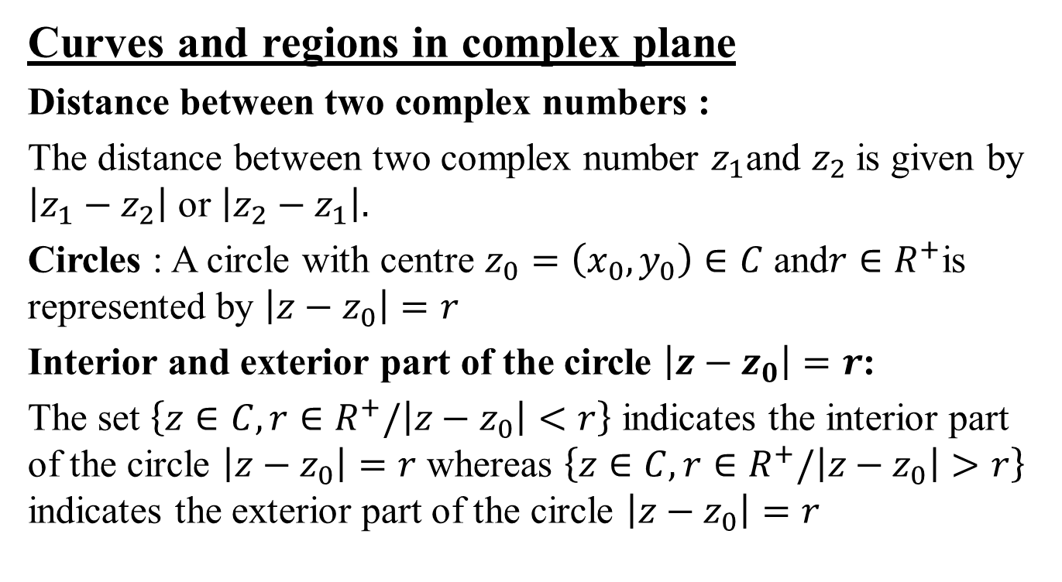
Complex variables(CO1)
Curves and regions in complex plane
Distance between two complex numbers :
The distance between two complex number $z_{1}$and $z_{2}$is given by $\left|z_{1}−z_{2}\right|$ or $\left|z_{2}−z_{1}\right|.$
Circles : A circle with centre $z_{0}=\left(x_{0},y_{0}\right)∈C$ and$r∈R^{+}$is represented by $\left|z−z_{0}\right|=r$
Interior and exterior part of the circle $\left|z−z_{0}\right|=r$:
The set $\left\{z∈C,r∈R^{+}/\left|z−z_{0}\right|<r\right\}$ indicates the interior part of the circle $\left|z−z_{0}\right|=r$ whereas $\left\{z∈C,r∈R^{+}/\left|z−z_{0}\right|>r\right\}$ indicates the exterior part of the circle $\left|z−z_{0}\right|=r$

Slide 35
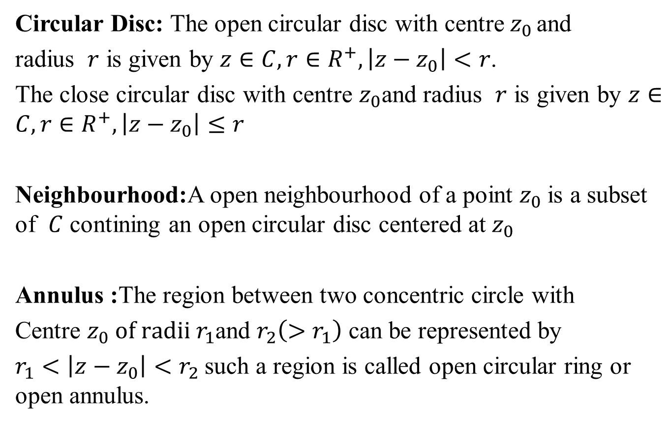
Complex variables(CO1)
Circular Disc: The open circular disc with centre${ z}_{0 }$and
radius $r$ is given by $z∈C,r∈R^{+}, \left|z−z_{0}\right|<r$.
The close circular disc with centre $z_{0}$and radius $r$ is given by $z∈C,r∈R^{+}, \left|z−z_{0}\right|≤r$
Neighbourhood:A open neighbourhood of a point $z_{0}$is a subset of $C$ contining an open circular disc centered at $z_{0}$
Annulus :The region between two concentric circle with
Centre $z_{0} of radii r_{1}$and $r_{2}\left(>r_{1}\right)$ can be represented by
$r_{1}<\left|z−z_{0}\right|<r_{2}$such a region is called open circular ring or open annulus.

Slide 36
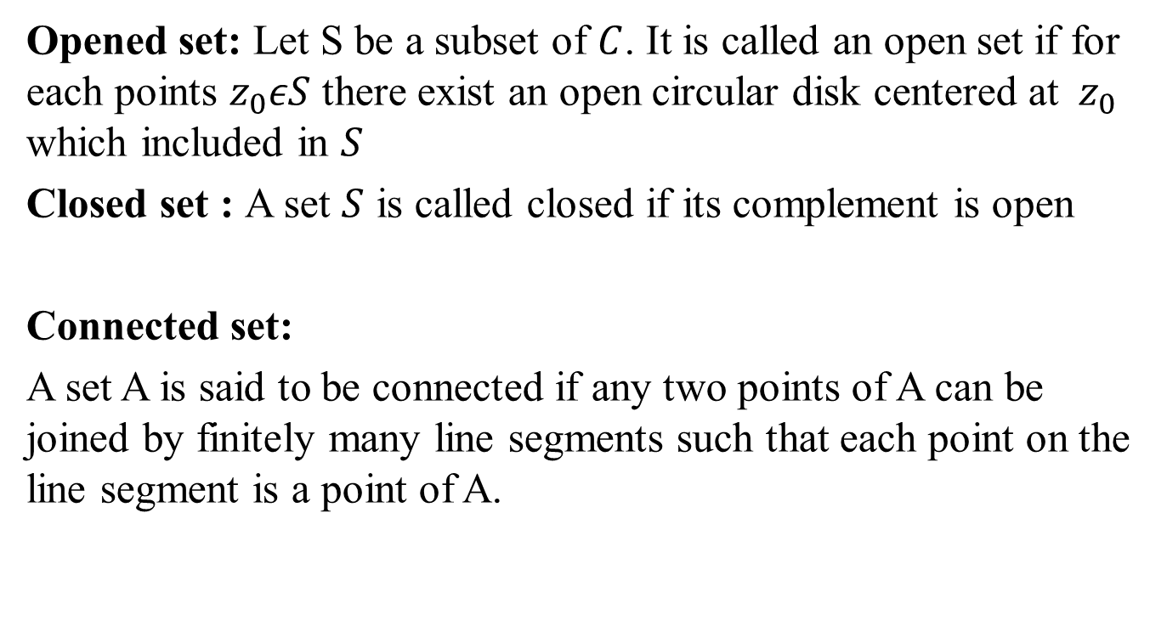
Complex variables (CO1)
Opened set: Let S be a subset of $C$. It is called an open set if for each points $z_{0}εS$ there exist an open circular disk centered at${ z}_{0}$ which included in $S$
Closed set : A set $S$ is called closed if its complement is open
Connected set:
A set A is said to be connected if any two points of A can be joined by finitely many line segments such that each point on the line segment is a point of A.

Slide 37
Complex variables(CO1)
Domain: A open connected set is called domain.
Region: It is a domain with some of its boundary points.
Closed region: It is a region together with a boundary points.
Bounded region: A region is said to be bounded if it can be enclosed in a circle of finite radius.

Slide 38
Recap(CO1)
Complex variables.
Curves and region in complex plane

Slide 39
Topic Objective(CO1)
We will discuss properties of a complex function which enables us when limit exist? When function is continuous as well as differentiable and analytic?

Slide 40
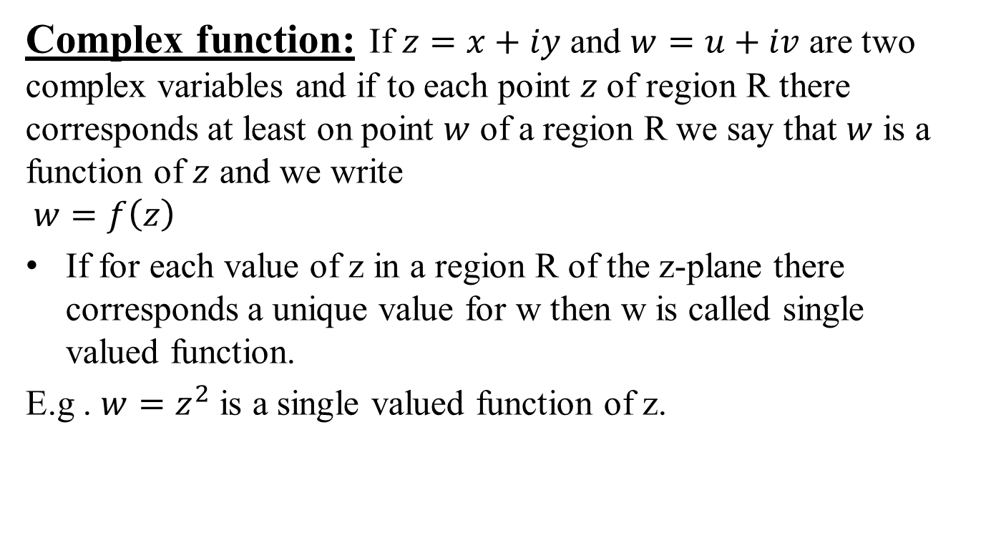
Function of complex variable(CO1)
Complex function: If $z=x+iy$ and $w=u+iv$ are two complex variables and if to each point $z$ of region R there corresponds at least on point $w$ of a region R we say that $w$ is a function of $z$ and we write
$$w=f\left(z\right)$$
If for each value of z in a region R of the z-plane there corresponds a unique value for w then w is called single valued function.
E.g . $w=z^{2}$ is a single valued function of z.

Slide 41
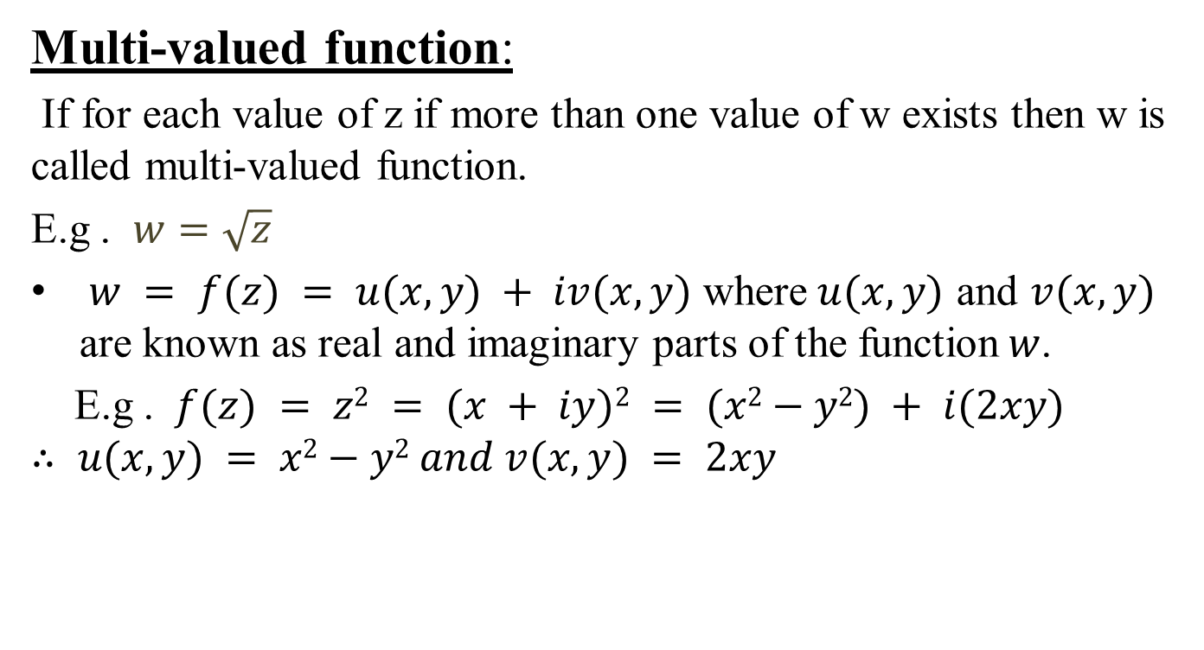
Function of complex variable(CO1)
Multi-valued function:
If for each value of z if more than one value of w exists then w is called multi-valued function.
E.g . $w=\sqrt{z}$
$w = f(z) = u(x, y) + iv(x, y)$ where$u(x, y)$ and $v(x, y)$ are known as real and imaginary parts of the function$w$.
E.g . $f(z) = z2 = (x + iy)2 = (x2−y2) + i(2xy)$
$$∴ u(x, y) = x2−y2 and v(x, y) = 2xy$$

Slide 42
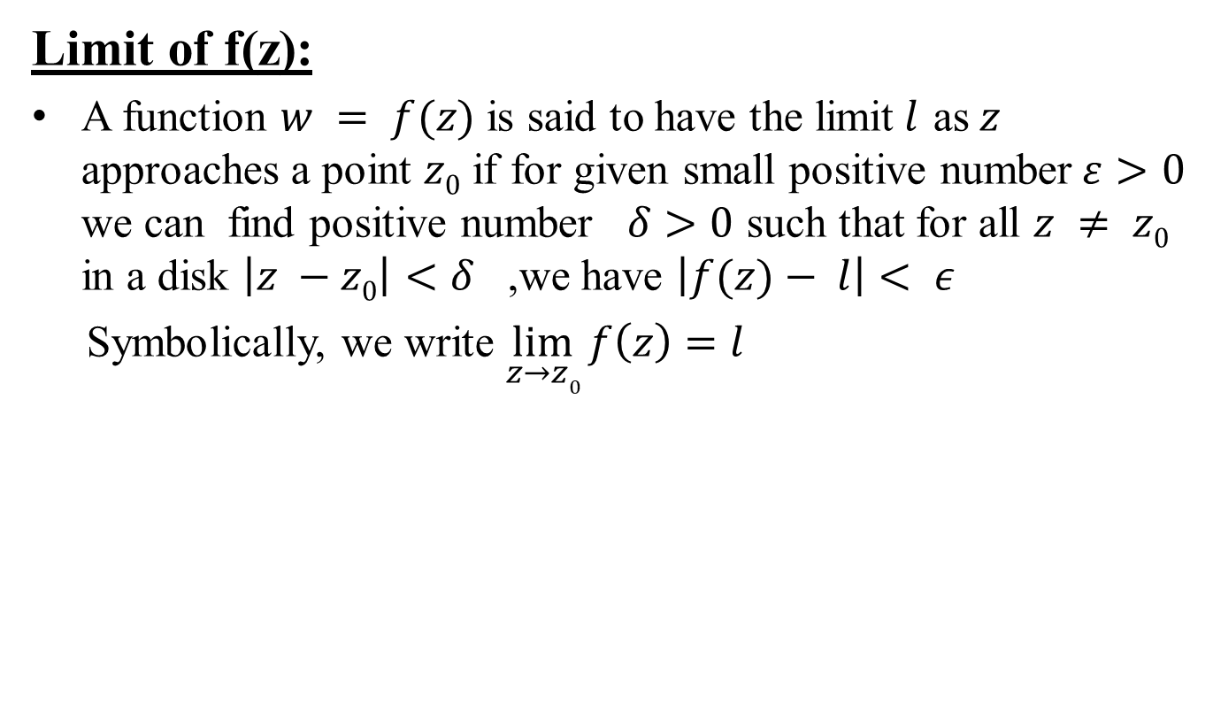
Function of complex variable(CO1)
Limit of f(z):
A function $w = f(z)$ is said to have the limit$l$ as$z$ approaches a point $z0$ if for given small positive number$ε>0$ we can find positive number $δ>0$ such that for all $z ≠ z0$ in a disk $\left|z −z0\right|<δ$ ,we have $\left|f(z)− l\right|< ε$
Symbolically, we write $\lim_{z→z0}{f\left(z\right)=l}$

Slide 43
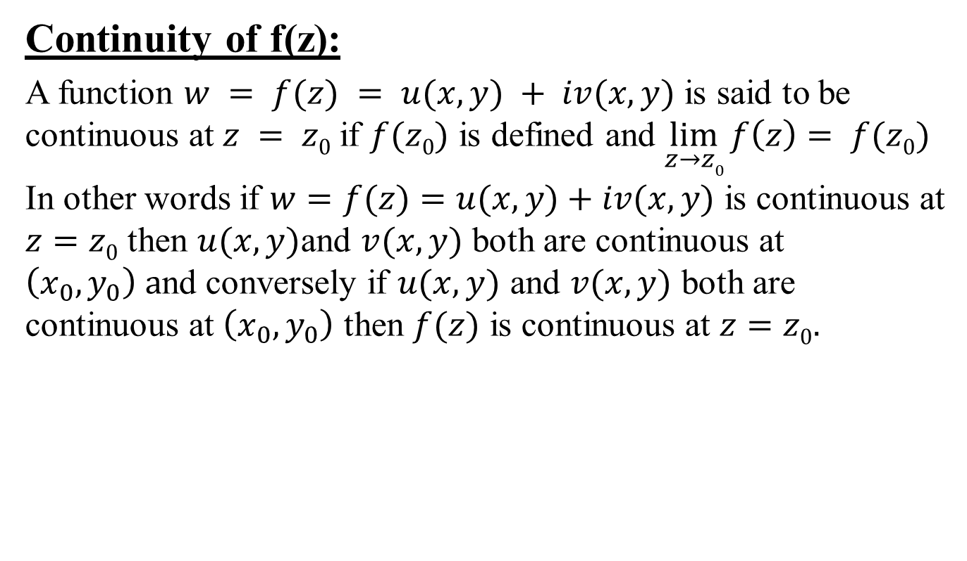
Function of complex variable(CO1)
Continuity of f(z):
A function $w = f(z) = u(x, y) + iv(x, y)$ is said to be continuous at $z = z0$if $f(z0)$ is defined and $\lim_{z→z0}{f\left(z\right)}= f(z0)$
In other words if $w=f(z)=u(x, y)+iv(x, y)$ is continuous at $z=z0$ then $u(x, y)$and $v(x, y)$ both are continuous at $\left(x_{0},y_{0}\right) a$nd conversely if $u(x, y)$ and $v(x, y)$ both are continuous at $\left(x_{0},y_{0}\right)$ then $f(z)$ is continuous at $z=z0.$

Slide 44
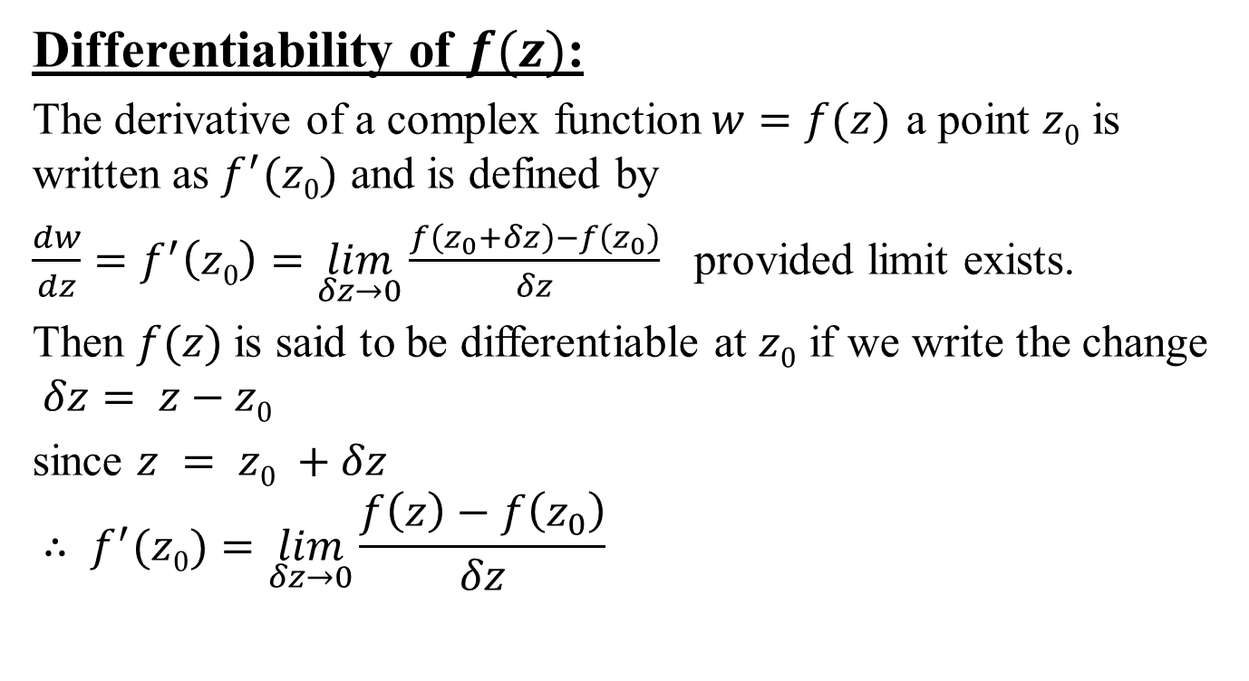
Function of complex variable(CO1)
Differentiability of $f(z)$:
The derivative of a complex function$w=f(z)$ a point $z0$ is written as $f^{′}(z0)$ and is defined by
$\frac{dw}{dz}=f^{′}\left(z0\right)=\lim_{δz→0}{\frac{f\left(z_{0}+δz\right)−f\left(z_{0}\right)}{δz}}$ provided limit exists.
Then $f(z)$is said to be differentiable at $z0$ if we write the change $δz= z−z0$
since $z = z0 +δz$
$$∴ f^{′}(z0)=\lim_{δz→0}{\frac{f\left(z\right)−f\left(z_{0}\right)}{δz}}$$

Slide 45
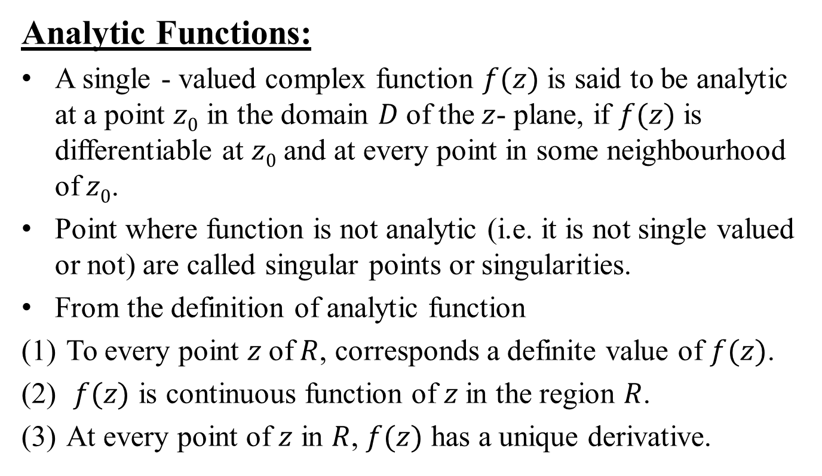
Function of complex variable(CO1)
Analytic Functions:
A single - valued complex function $f(z)$ is said to be analytic at a point $z0$ in the domain $D$of the$z$- plane, if $f(z)$ is differentiable at $z0$and at every point in some neighbourhood of$z0$.
Point where function is not analytic (i.e. it is not single valued or not) are called singular points or singularities.
From the definition of analytic function
To every point $z$of$R$, corresponds a definite value of $f(z)$.
$f(z)$ is continuous function of $z$in the region $R$.
At every point of $z$ in $R$, $f(z)$ has a unique derivative.

Slide 46
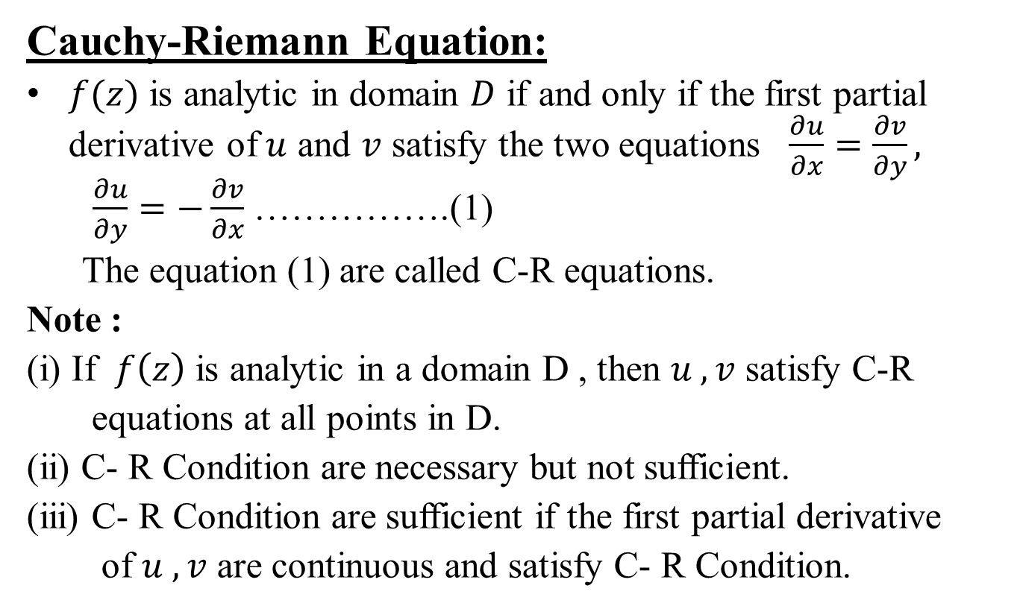
Function of complex variable(CO1)
Cauchy-Riemann Equation:
$f(z)$ is analytic in domain $D$ if and only if the first partial derivative of$u$ and $v$ satisfy the two equations $\frac{∂u}{∂x}=\frac{∂v}{∂y}, \frac{∂u}{∂y}=−\frac{∂v}{∂x}$ …………….(1)
The equation (1) are called C-R equations.
Note :
(i) If $f\left(z\right)$ is analytic in a domain D , then $u ,v$ satisfy C-R
equations at all points in D.
(ii) C- R Condition are necessary but not sufficient.
(iii) C- R Condition are sufficient if the first partial derivative
of $u ,v$ are continuous and satisfy C- R Condition.

Slide 47
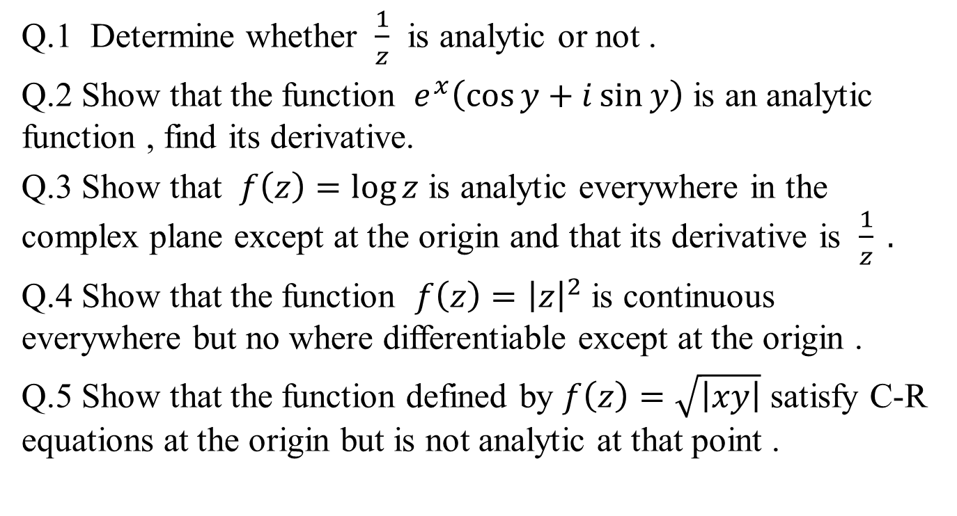
Daily Quiz(CO1)
Q.1 Determine whether $\frac{1}{z}$ is analytic or not .
Q.2 Show that the function $e^{x}\left(\cos{y}+i\sin{y}\right)$ is an analytic function , find its derivative.
Q.3 Show that $f\left(z\right)=\log{z}$ is analytic everywhere in the complex plane except at the origin and that its derivative is $\frac{1}{z} .$
Q.4 Show that the function $f\left(z\right)={\left|z\right|}^{2}$ is continuous everywhere but no where differentiable except at the origin .
Q.5 Show that the function defined by $f\left(z\right)=\sqrt{\left|xy\right|}$ satisfy C-R equations at the origin but is not analytic at that point .

Slide 48
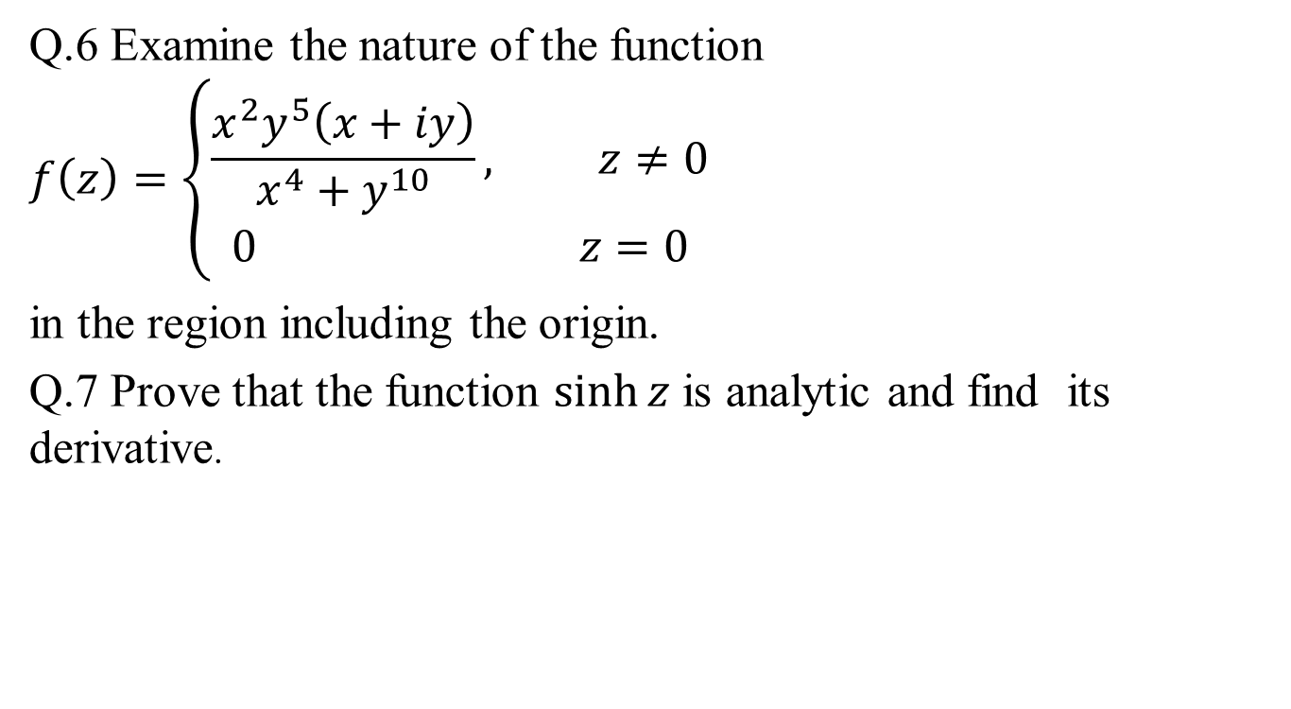
Daily Quiz(CO1)
Q.6 Examine the nature of the function
$$f\left(z\right)=\left\{\begin{aligned}\frac{x^{2}y^{5}\left(x+iy\right)}{x^{4}+y^{10}}, z≠0 \\ 0 z=0\end{aligned}\right.$$
in the region including the origin.
Q.7 Prove that the function $\sinh{z}$ is analytic and find its derivative.

Slide 49
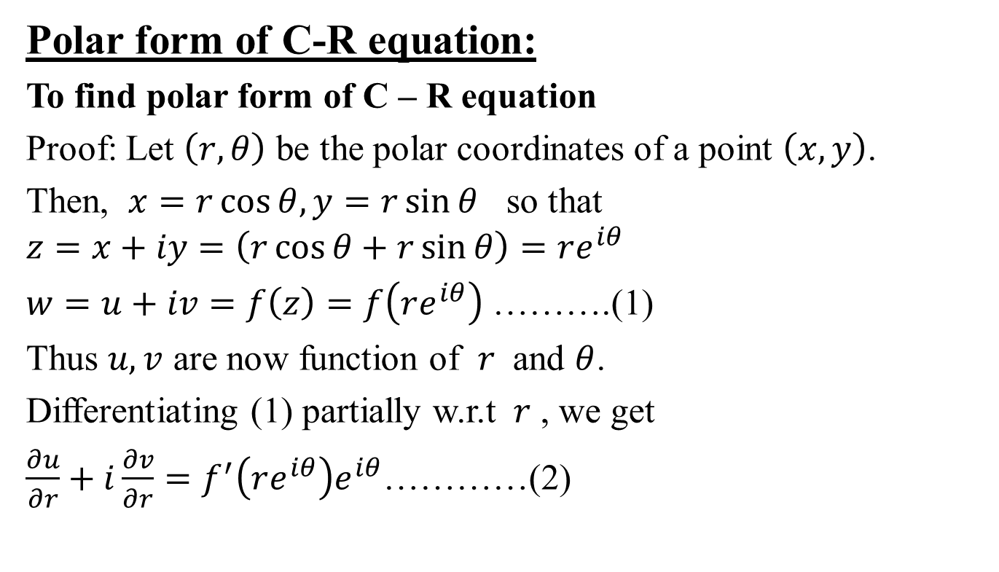
Function of complex variable (CO1)
Polar form of C-R equation:
To find polar form of C – R equation
Proof: Let $\left(r,θ\right)$ be the polar coordinates of a point $\left(x,y\right)$.
Then, $x=r\cos{θ,y=r\sin{θ}}$ so that
$$z=x+iy=\left(r\cos{θ+r\sin{θ}}\right)=re^{iθ}$$
$w=u+iv=f\left(z\right)=f\left(re^{iθ}\right)$ ……….(1)
Thus $u,v$ are now function of $r$ and $θ$.
Differentiating (1) partially w.r.t $r$ , we get
$\frac{∂u}{∂r}+i\frac{∂v}{∂r}=f^{′}\left(re^{iθ}\right)e^{iθ}$…………(2)

Slide 50
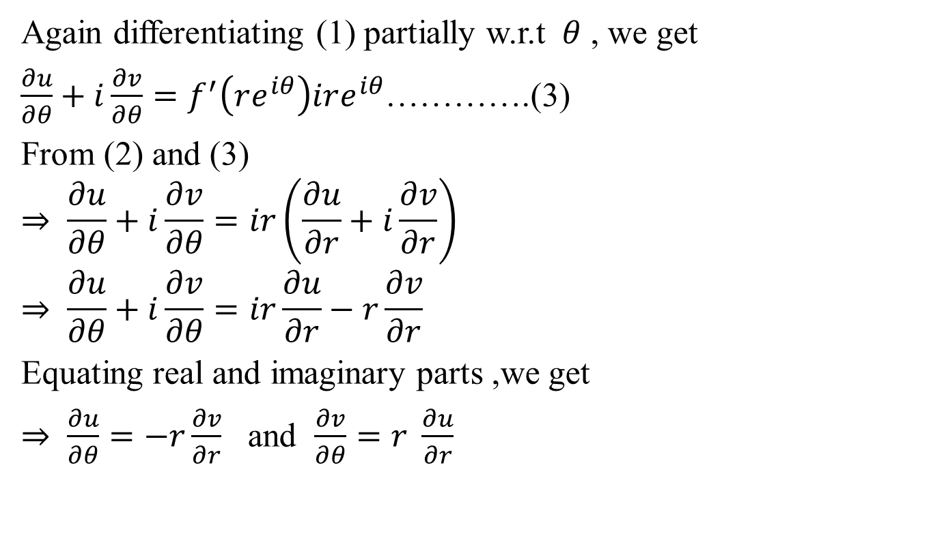
Function of complex variable (CO1)
Again differentiating (1) partially w.r.t $θ$ , we get
$\frac{∂u}{∂θ}+i\frac{∂v}{∂θ}=f^{′}\left(re^{iθ}\right)ire^{iθ}$………….(3)
From (2) and (3)
$$⇒ \frac{∂u}{∂θ}+i\frac{∂v}{∂θ}=ir\left(\frac{∂u}{∂r}+i\frac{∂v}{∂r}\right)$$
$$⇒ \frac{∂u}{∂θ}+i\frac{∂v}{∂θ}=ir\frac{∂u}{∂r}−r\frac{∂v}{∂r}$$
Equating real and imaginary parts ,we get
$⇒ \frac{∂u}{∂θ}=−r\frac{∂v}{∂r}$ and $\frac{∂v}{∂θ}=r \frac{∂u}{∂r}$

Slide 51
Topic objective (CO1)
We enable to find analytic function in terms of z if we have real or imaginary part of an analytic function.

Slide 52

Function of complex variable(CO1)
Laplace’s equation:
An equation in two variables $x$ and $y$ given by $\frac{∂^{2}f}{∂x^{2}}+\frac{∂^{2}f}{∂y^{2}}=0$is called as Laplace’s equation in two variables.

Slide 53
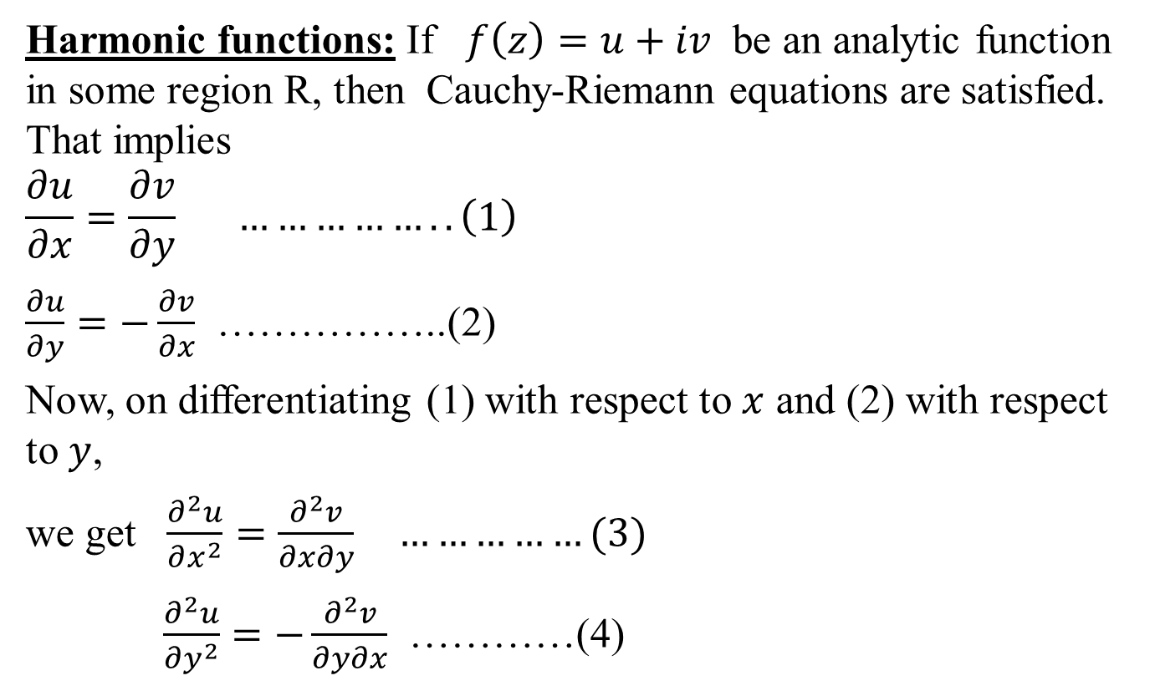
Function of complex variable(CO1)
Harmonic functions: If $f\left(z\right)=u+iv$ be an analytic function in some region R, then Cauchy-Riemann equations are satisfied. That implies
$$\frac{∂u}{∂x}=\frac{∂v}{∂y} ……………..\left(1\right)$$
$\frac{∂u}{∂y}=−\frac{∂v}{∂x}$ ……………..(2)
Now, on differentiating (1) with respect to $x$ and (2) with respect to $y$,
we get $\frac{∂^{2}u}{∂x^{2}}=\frac{∂^{2}v}{∂x∂y} ……………(3)$
$\frac{∂^{2}u}{∂y^{2}}=−\frac{∂^{2}v}{∂y∂x}$ …………(4)

Slide 54
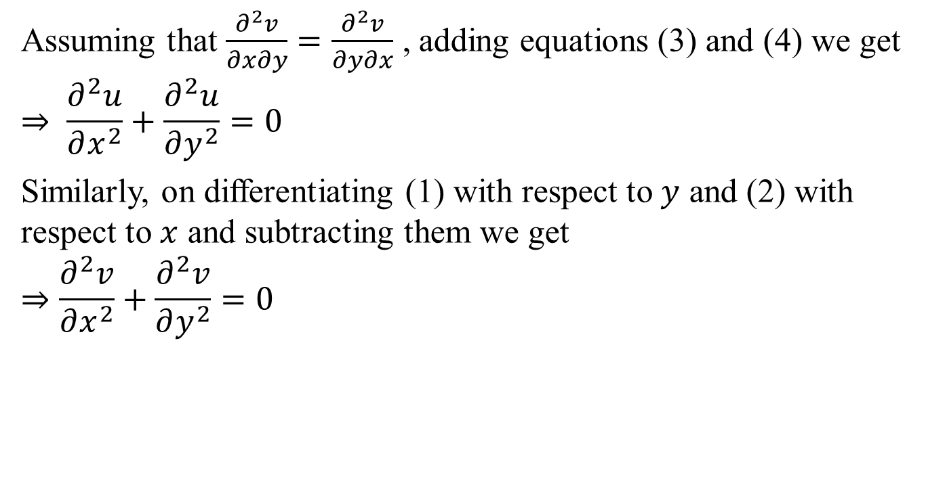
Function of complex variable(CO1)
Assuming that $\frac{∂^{2}v}{∂x∂y}=\frac{∂^{2}v}{∂y∂x}$ , adding equations (3) and (4) we get
$$⇒ \frac{∂^{2}u}{∂x^{2}}+\frac{∂^{2}u}{∂y^{2}}=0$$
Similarly, on differentiating (1) with respect to $y$ and (2) with respect to $x$ and subtracting them we get
$$⇒\frac{∂^{2}v}{∂x^{2}}+\frac{∂^{2}v}{∂y^{2}}=0$$

Slide 55
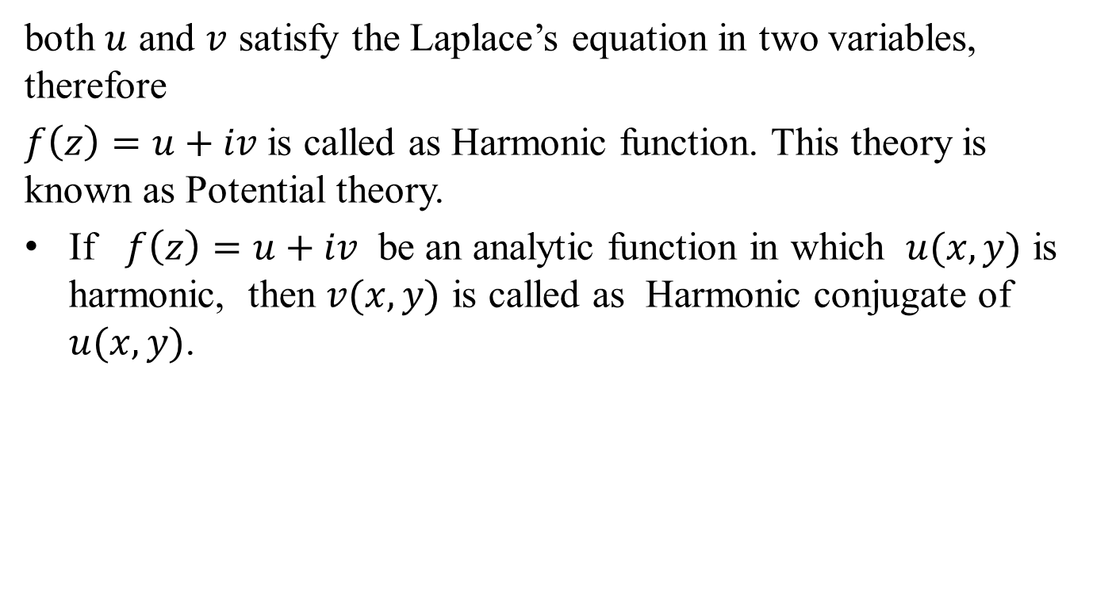
Function of complex variable(CO1)
both $u$ and $v$ satisfy the Laplace’s equation in two variables, therefore
$f\left(z\right)=u+iv$ is called as Harmonic function. This theory is known as Potential theory.
If $f\left(z\right)=u+iv$ be an analytic function in which $u(x, y)$ is harmonic, then $v(x, y)$ is called as Harmonic conjugate of $u(x, y)$.

Slide 56
Function of complex variable(CO1)
Determination of Analytic function whose real or imaginary part is Known:
If the real or the imaginary part of any analytic function is given, other part can be determined by using the following methods :
Direct Method
Milne-Thomson’s Method
Exact Differential equation method
Shortcut Method

Slide 57
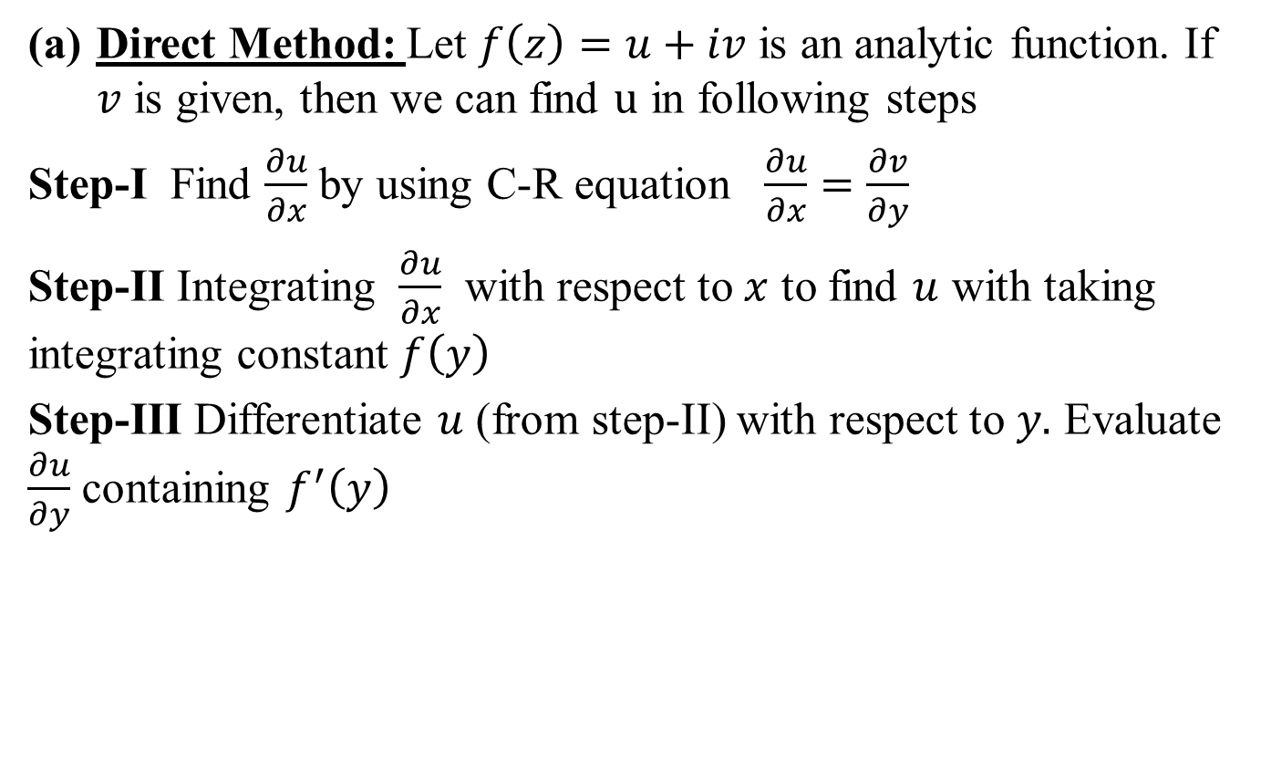
Function of complex variable (CO1)
Direct Method: Let $f\left(z\right)=u+iv$ is an analytic function. If $v$ is given, then we can find $u$ in following steps
Step-I Find $\frac{∂u}{∂x}$ by using C-R equation $\frac{∂u}{∂x}=\frac{∂v}{∂y}$
Step-II Integrating $\frac{∂u}{∂x}$ with respect to $x$ to find $u$ with taking integrating constant $f\left(y\right)$
Step-III Differentiate $u$ (from step-II) with respect to $y.$ Evaluate $\frac{∂u}{∂y}$ containing $f^{′}\left(y\right)$

Slide 58
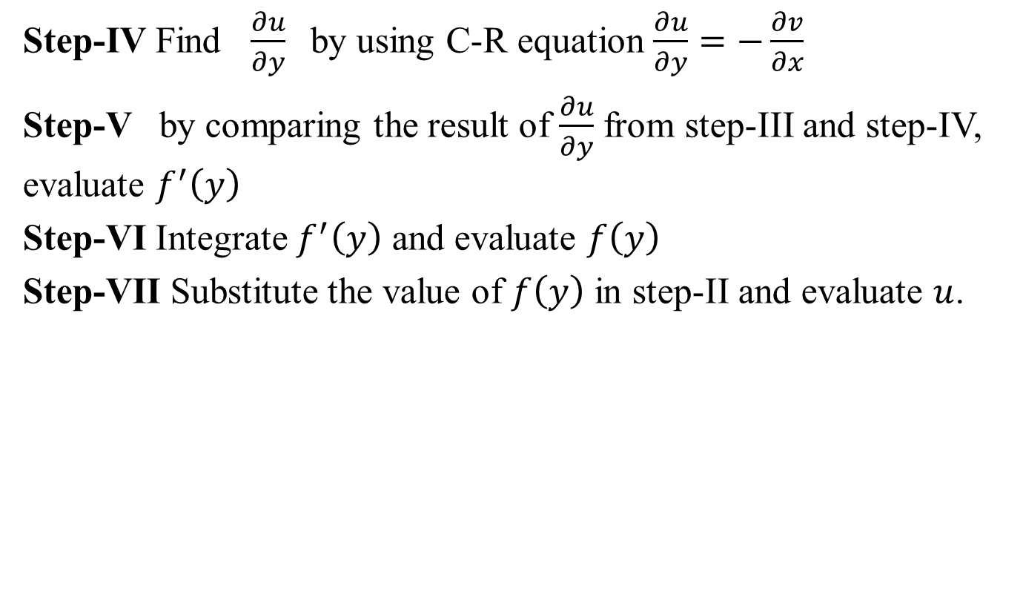
Function of complex variable (CO1)
Step-IV Find $\frac{∂u}{∂y}$by using C-R equation $\frac{∂u}{∂y}=−\frac{∂v}{∂x}$
Step-V by comparing the result of $\frac{∂u}{∂y}$ from step-III and step-IV, evaluate $f^{′}\left(y\right)$
Step-VI Integrate $f^{′}\left(y\right)$ and evaluate $f\left(y\right)$
Step-VII Substitute the value of $f\left(y\right)$ in step-II and evaluate $u$.

Slide 59
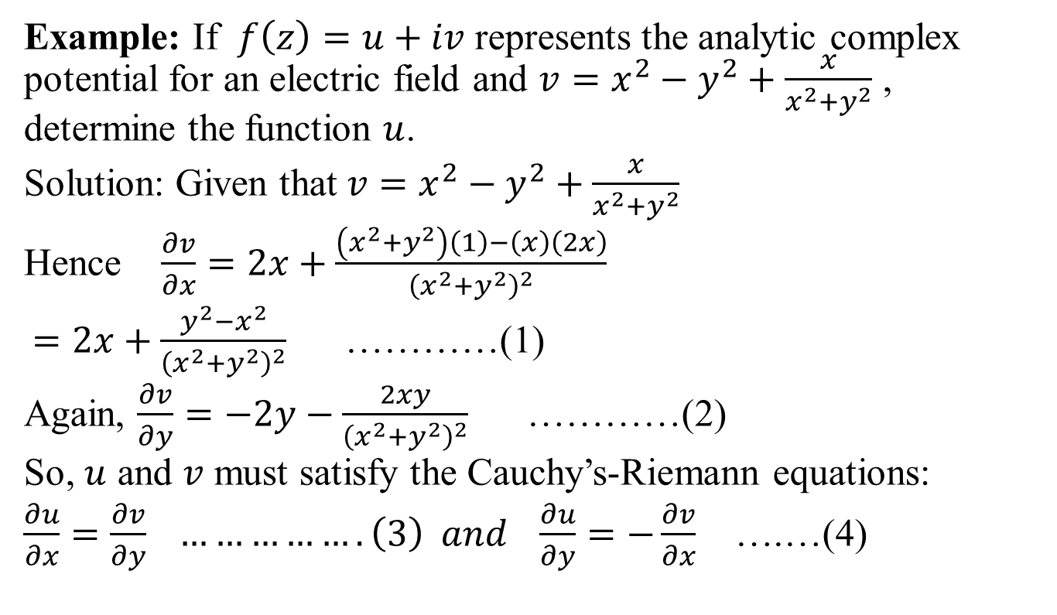
Function of complex variable(CO1)
Example: If $f\left(z\right)=u+iv$ represents the analytic complex potential for an electric field and $v=x^{2}−y^{2}+\frac{x}{x^{2}+y^{2}}$ , determine the function $u$.
Solution: Given that$v=x^{2}−y^{2}+\frac{x}{x^{2}+y^{2}}$
Hence $\frac{∂v}{∂x}=2x+\frac{\left(x^{2}+y^{2}\right)\left(1\right)−\left(x\right)\left(2x\right)}{{\left(x^{2}+y^{2}\right)}^{2}}$
$=2x+\frac{y^{2}−x^{2}}{{\left(x^{2}+y^{2}\right)}^{2}}$ …………(1)
Again, $\frac{∂v}{∂y}=−2y−\frac{2xy}{{\left(x^{2}+y^{2}\right)}^{2}}$ …………(2)
So, $u$ and $v$ must satisfy the Cauchy’s-Riemann equations:
$\frac{∂u}{∂x}=\frac{∂v}{∂y} …………….\left(3\right) and \frac{∂u}{∂y}=−\frac{∂v}{∂x}$ ….…(4)

Slide 60
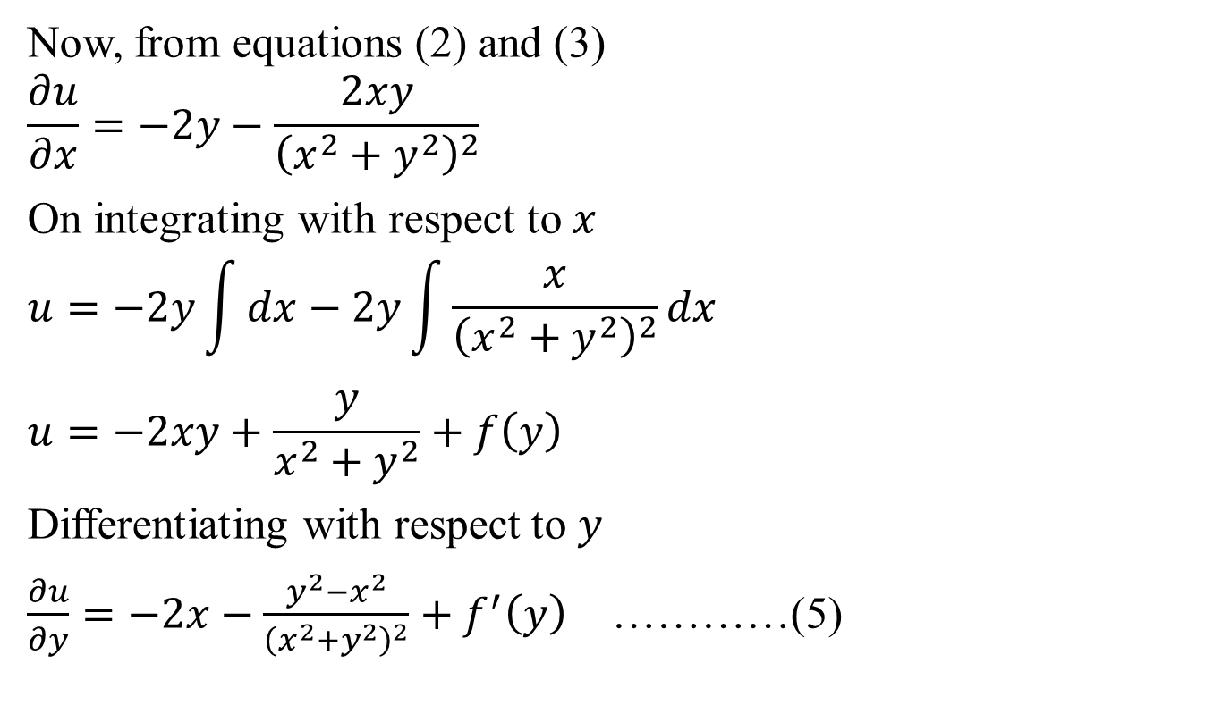
Function of complex variable(CO1)
Now, from equations (2) and (3)
$$\frac{∂u}{∂x}=−2y−\frac{2xy}{{\left(x^{2}+y^{2}\right)}^{2}}$$
On integrating with respect to $x$
$$u=−2y\int{dx}−2y\int{\frac{x}{{\left(x^{2}+y^{2}\right)}^{2}}dx}$$
$$u=−2xy+\frac{y}{x^{2}+y^{2}}+f\left(y\right)$$
Differentiating with respect to $y$
$\frac{∂u}{∂y}=−2x−\frac{y^{2}−x^{2}}{{\left(x^{2}+y^{2}\right)}^{2}}+f^{′}\left(y\right)$ …………(5)

Slide 61

Function of complex variable(CO1)
Again, from equations (1) and (4)
$\frac{∂u}{∂y}=−2x−\frac{y^{2}−x^{2}}{{\left(x^{2}+y^{2}\right)}^{2}}$ ………….(6)
On comparing (5) and (6)
$f^{′}\left(y\right)=0$ , So $f\left(y\right)=k$
Hence, $u=−2xy+\frac{y}{x^{2}+y^{2}}+k$

Slide 62
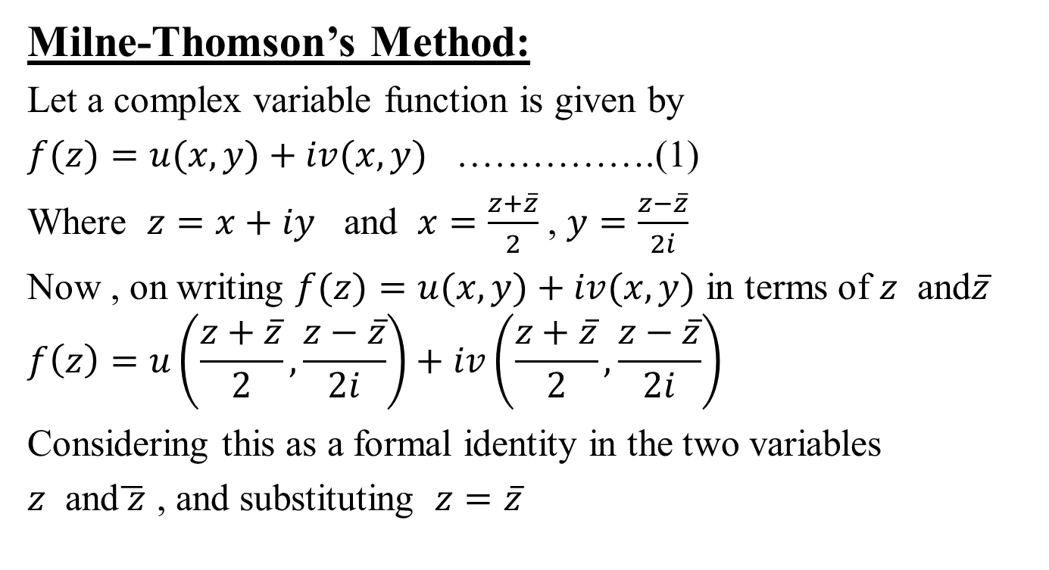
Function of complex variable(CO1)
Milne-Thomson’s Method:
Let a complex variable function is given by
$f(z)=u(x, y)+iv(x, y)$ …………….(1)
Where $z=x+iy$ and $x=\frac{z+\overline{z}}{2}$ , $y=\frac{z−\overline{z}}{2i}$
Now , on writing $f(z)=u(x, y)+iv(x, y)$ in terms of $z$ and$\overline{z}$
$$f\left(z\right)=u\left(\frac{z+\overline{z}}{2},\frac{z−\overline{z}}{2i}\right)+iv\left(\frac{z+\overline{z}}{2},\frac{z−\overline{z}}{2i}\right)$$
Considering this as a formal identity in the two variables
$z$ and$\overline{ z}$ , and substituting $z=\overline{z}$

Slide 63
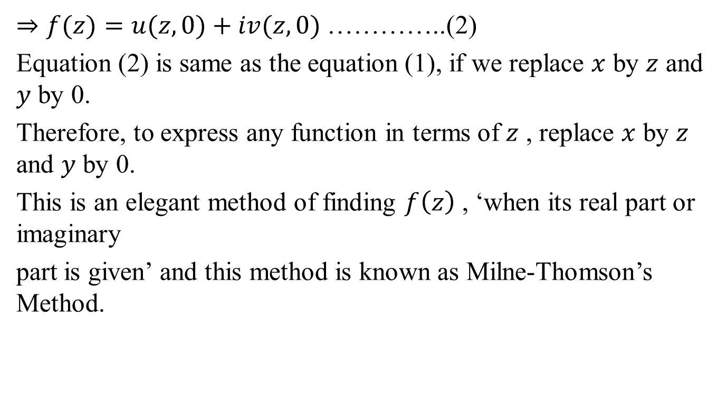
Function of complex variable(CO1)
$⇒f(z)=u(z, 0)+iv(z, 0)$ …………..(2)
Equation (2) is same as the equation (1), if we replace $x$ by $z$ and $y$ by 0.
Therefore, to express any function in terms of $z$ , replace $x$ by $z$ and $y$ by 0.
This is an elegant method of finding $f\left(z\right)$ , ‘when its real part or imaginary
part is given’ and this method is known as Milne-Thomson’s Method.

Slide 64
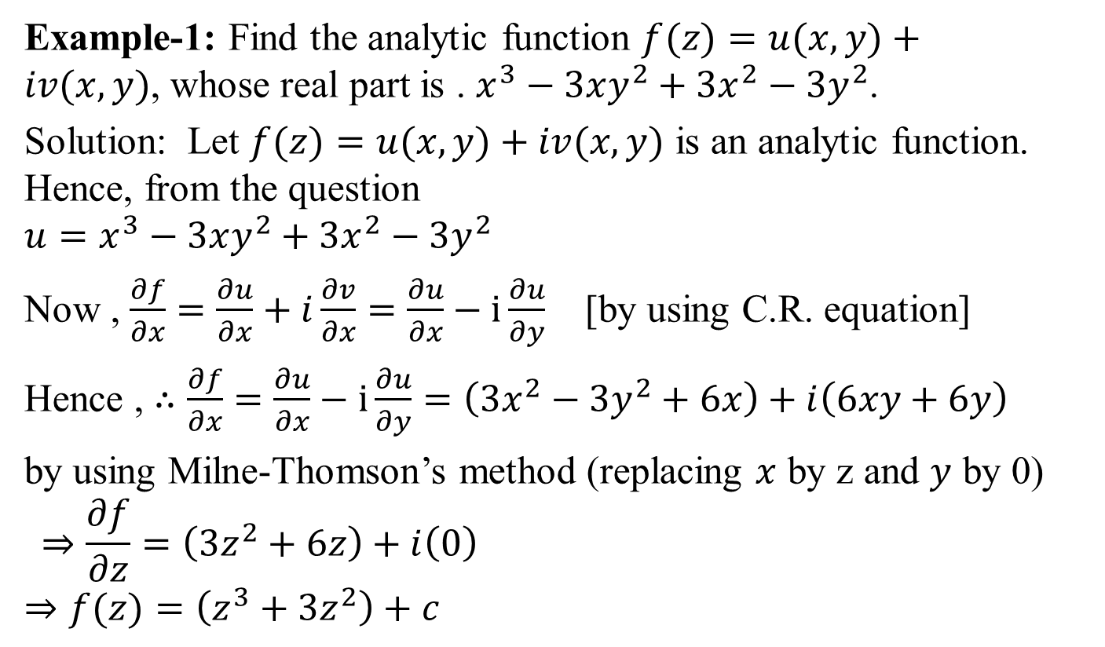
Function of complex variable(CO1)
Example-1: Find the analytic function $f(z)=u(x, y)+iv(x, y)$, whose real part is . $x^{3}−3xy^{2}+3x^{2}−3y^{2}$.
Solution: Let $f(z)=u(x, y)+iv(x, y)$ is an analytic function. Hence, from the question
$${u=x}^{3}−3xy^{2}+3x^{2}−3y^{2}$$
Now , $\frac{∂f}{∂x}=\frac{∂u}{∂x}+i\frac{∂v}{∂x}=\frac{∂u}{∂x}−i\frac{∂u}{∂y}$ [by using C.R. equation]
Hence , $∴\frac{∂f}{∂x}=\frac{∂u}{∂x}−i\frac{∂u}{∂y}=\left(3x^{2}−3y^{2}+6x\right)+i\left(6xy+6y\right)$
by using Milne-Thomson’s method (replacing $x$ by z and $y$ by 0)
$$⇒\frac{∂f}{∂z}=\left(3z^{2}+6z\right)+i\left(0\right)$$
$$⇒f(z)=\left(z^{3}+3z^{2}\right)+c$$

Slide 65

Function of complex variable(CO1)
Hence , $v=Im\left[z^{3}+3z^{2}+ic\right]$
$$=Im\left[x^{3}−iy^{3}+i3x^{2}y−3xy^{2}+3x^{2}−3y^{2}+i6xy+ic\right]$$
$$∴ v=3x^{2}y−y^{3}+6xy+c$$
Therefore,
$$f(z)=\left(x^{3}−3xy^{2}+3x^{2}−3y^{2}\right)+i\left(3x^{2}y− y^{3}+6xy+c\right)$$

Slide 66
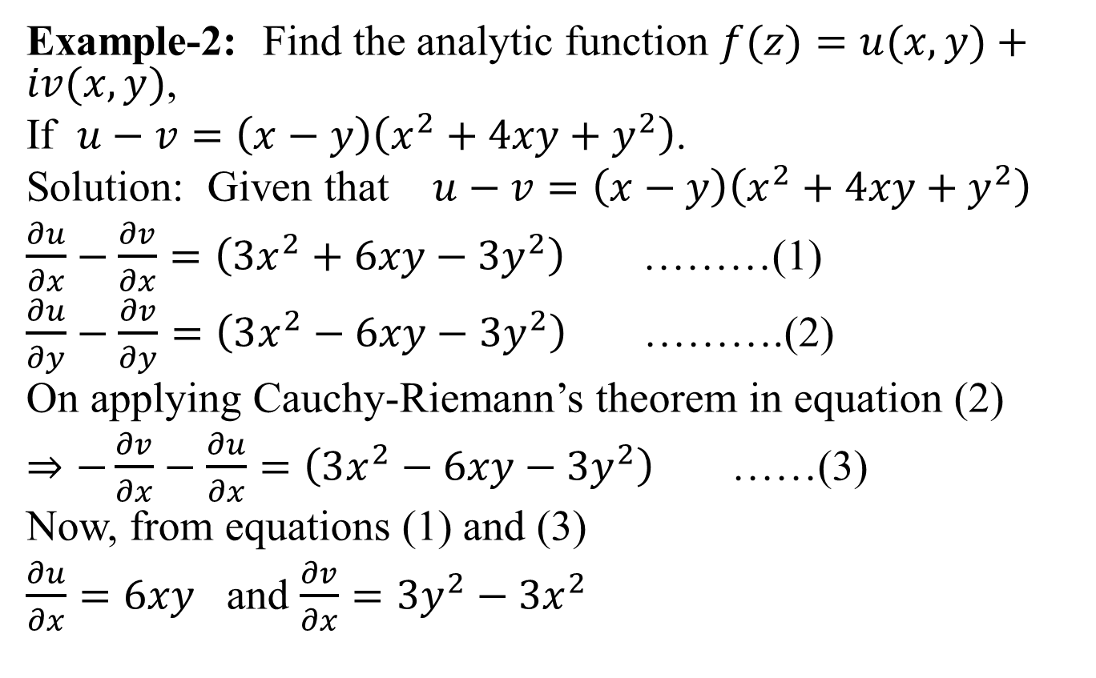
Function of complex variable(CO1)
Example-2: Find the analytic function $f(z)=u(x, y)+iv(x, y)$,
If $u−v=\left(x−y\right)\left(x^{2}+4xy+y^{2}\right)$.
Solution: Given that $u−v=\left(x−y\right)\left(x^{2}+4xy+y^{2}\right)$
$\frac{∂u}{∂x}−\frac{∂v}{∂x}=\left(3x^{2}+6xy−3y^{2}\right)$ ………(1)
$\frac{∂u}{∂y}−\frac{∂v}{∂y}=\left(3x^{2}−6xy−3y^{2}\right)$ ……….(2)
On applying Cauchy-Riemann’s theorem in equation (2)
$⇒−\frac{∂v}{∂x}−\frac{∂u}{∂x}=\left(3x^{2}−6xy−3y^{2}\right)$ ……(3)
Now, from equations (1) and (3)
$\frac{∂u}{∂x}=6xy$ and $\frac{∂v}{∂x}=3y^{2}−3x^{2}$

Slide 67
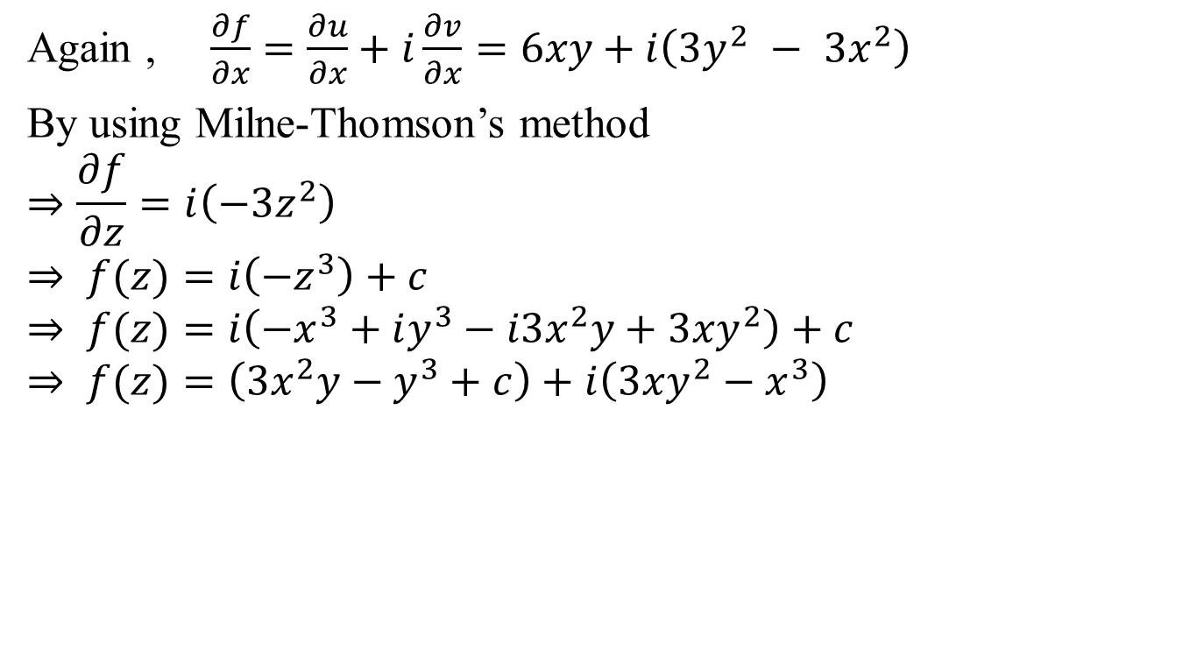
Function of complex variable(CO1)
Again , $\frac{∂f}{∂x}=\frac{∂u}{∂x}+i\frac{∂v}{∂x}=6xy+i\left(3y^{2} − 3x^{2}\right)$
By using Milne-Thomson’s method
$$⇒\frac{∂f}{∂z}=i\left(−3z^{2}\right)$$
$$⇒ f(z)=i\left(−z^{3}\right)+c$$
$$⇒ f(z)=i\left(−x^{3}+iy^{3}−i3x^{2}y+3xy^{2}\right)+c$$
$$⇒ f(z)=\left(3x^{2}y−y^{3}+c\right)+i\left(3xy^{2}−x^{3}\right)$$

Slide 68
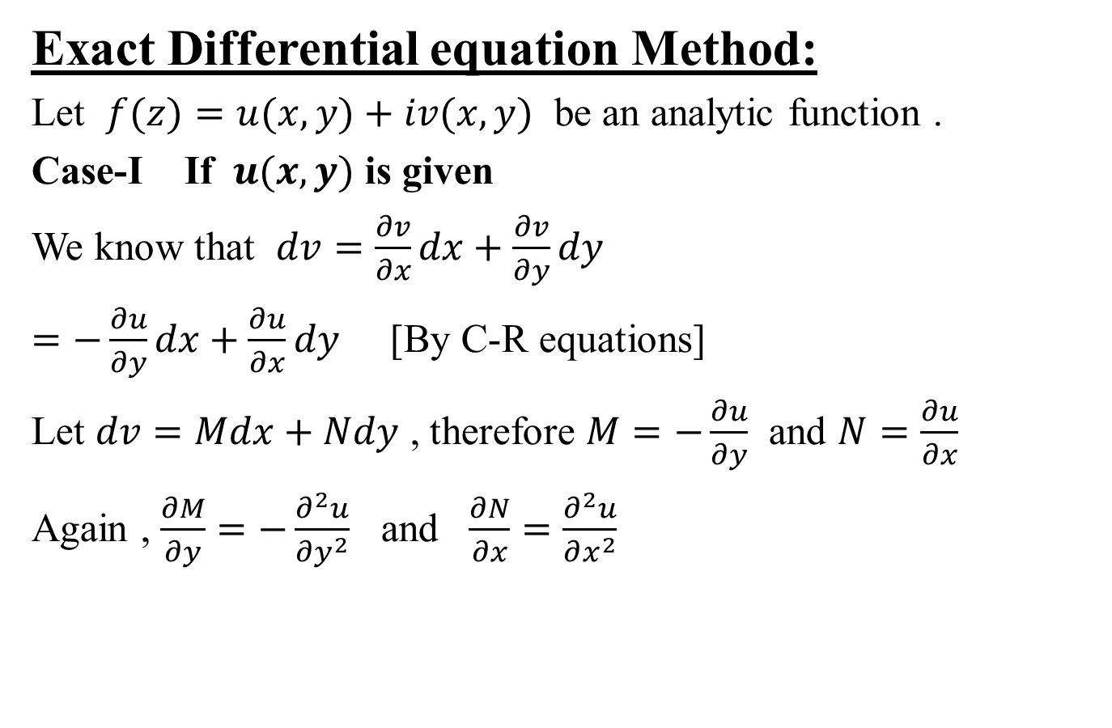
Function of complex variable(CO1)
Exact Differential equation Method:
Let $f(z)=u(x, y)+iv(x, y)$ be an analytic function .
Case-I If $u(x, y)$ is given
We know that $dv=\frac{∂v}{∂x}dx+\frac{∂v}{∂y}dy$
$=−\frac{∂u}{∂y}dx+\frac{∂u}{∂x}dy$ [By C-R equations]
Let $dv=Mdx+Ndy$ , therefore $M=−\frac{∂u}{∂y}$ and $N=\frac{∂u}{∂x}$
Again , $\frac{∂M}{∂y}=−\frac{∂^{2}u}{∂y^{2}}$ and $\frac{∂N}{∂x}=\frac{∂^{2}u}{∂x^{2}}$

Slide 69
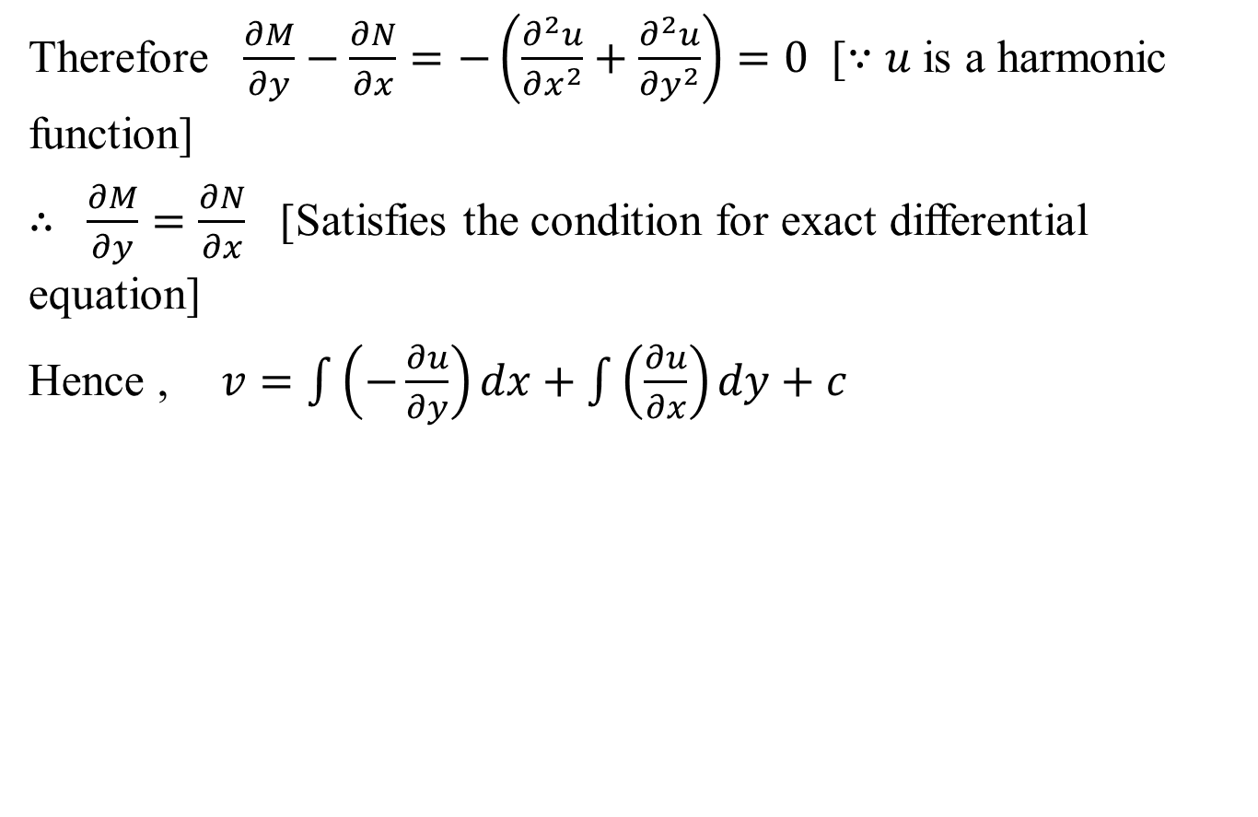
Function of complex variable(CO1)
Therefore $\frac{∂M}{∂y}−\frac{∂N}{∂x}=−\left(\frac{∂^{2}u}{∂x^{2}}+\frac{∂^{2}u}{∂y^{2}}\right)=0$ [∵ $u$is a harmonic function]
$∴ \frac{∂M}{∂y}=\frac{∂N}{∂x}$ [Satisfies the condition for exact differential equation]
Hence , $v=\int{\left(−\frac{∂u}{∂y}\right)dx+\int{\left(\frac{∂u}{∂x}\right)}dy+c}$

Slide 70
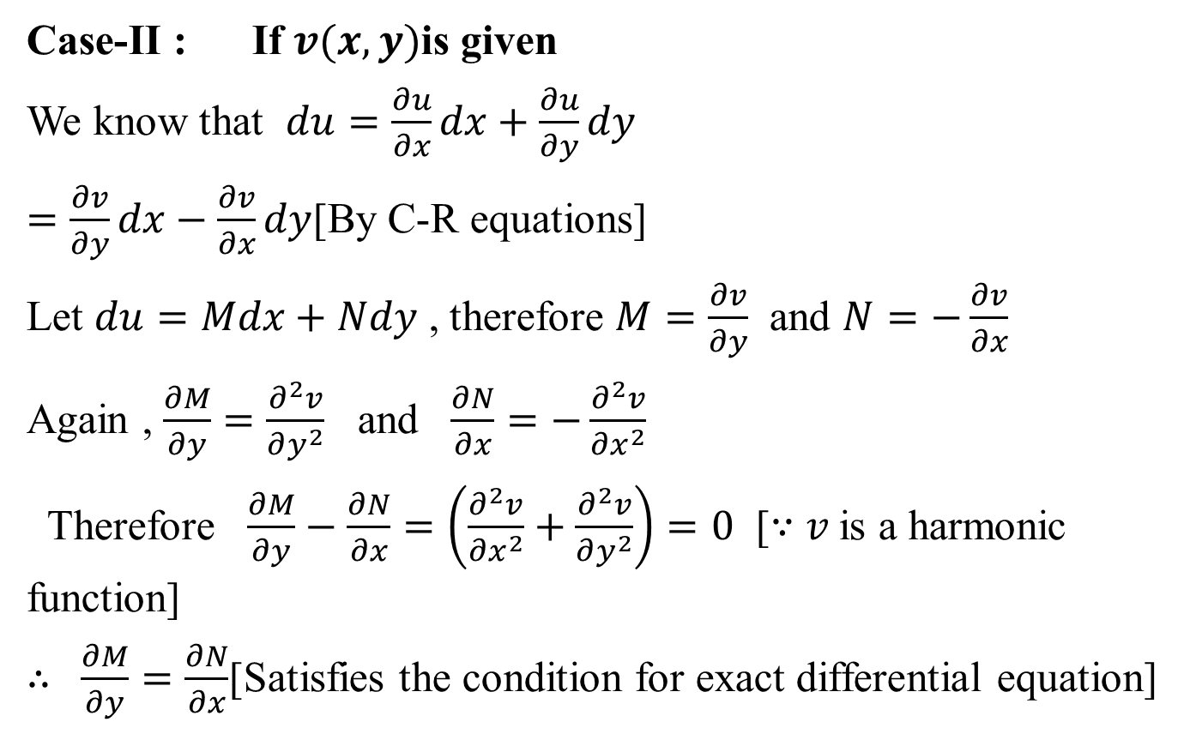
Function of complex variable (CO1)
Case-II : If $v(x, y)$is given
We know that $du=\frac{∂u}{∂x}dx+\frac{∂u}{∂y}dy$
$=\frac{∂v}{∂y}dx−\frac{∂v}{∂x}dy$[By C-R equations]
Let $du=Mdx+Ndy$ , therefore $M=\frac{∂v}{∂y}$ and $N=−\frac{∂v}{∂x}$
Again , $\frac{∂M}{∂y}=\frac{∂^{2}v}{∂y^{2}}$ and $\frac{∂N}{∂x}=−\frac{∂^{2}v}{∂x^{2}}$
Therefore $\frac{∂M}{∂y}−\frac{∂N}{∂x}=\left(\frac{∂^{2}v}{∂x^{2}}+\frac{∂^{2}v}{∂y^{2}}\right)=0$ [∵ $v$is a harmonic function]
$∴ \frac{∂M}{∂y}=\frac{∂N}{∂x}$[Satisfies the condition for exact differential equation]

Slide 71
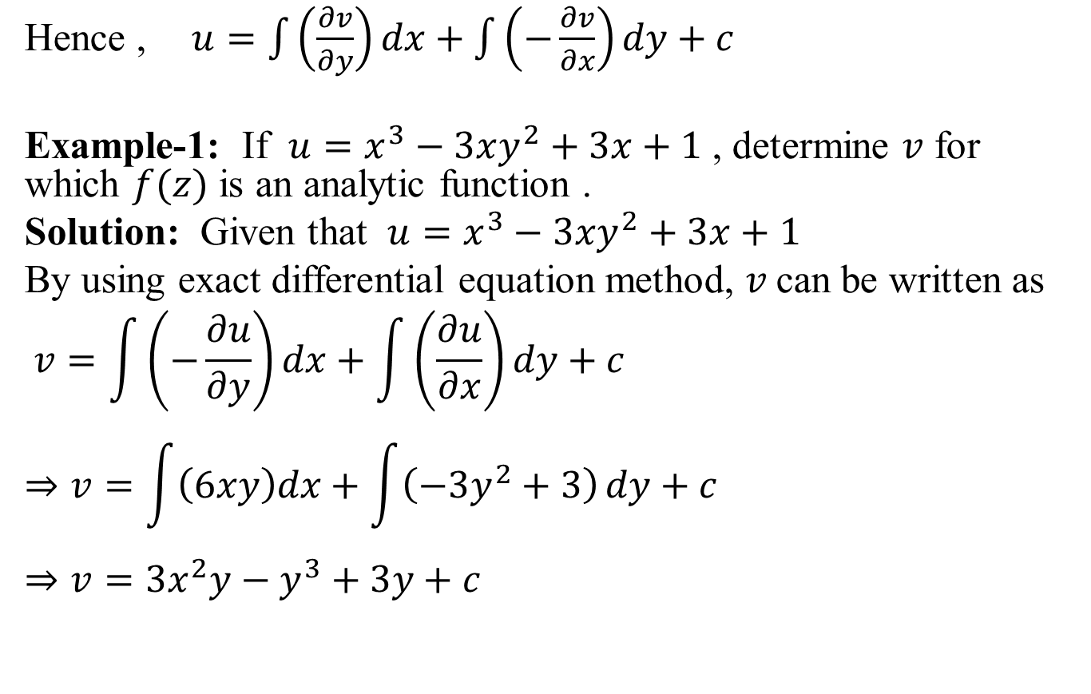
Function of complex variable(CO1)
Hence , $u=\int{\left(\frac{∂v}{∂y}\right)dx+\int{\left(−\frac{∂v}{∂x}\right)}dy+c}$
Example-1: If $u=x^{3}−3xy^{2}+3x+1$ , determine $v$ for which $f(z)$ is an analytic function .
Solution: Given that $u=x^{3}−3xy^{2}+3x+1$
By using exact differential equation method, $v$can be written as
$$v=\int{\left(−\frac{∂u}{∂y}\right)dx+\int{\left(\frac{∂u}{∂x}\right)}dy+c}$$
$$⇒v=\int{\left(6xy\right)dx+\int{\left(−3y^{2}+3\right)}dy+c}$$
$$⇒v=3x^{2}y−y^{3}+3y+c$$

Slide 72
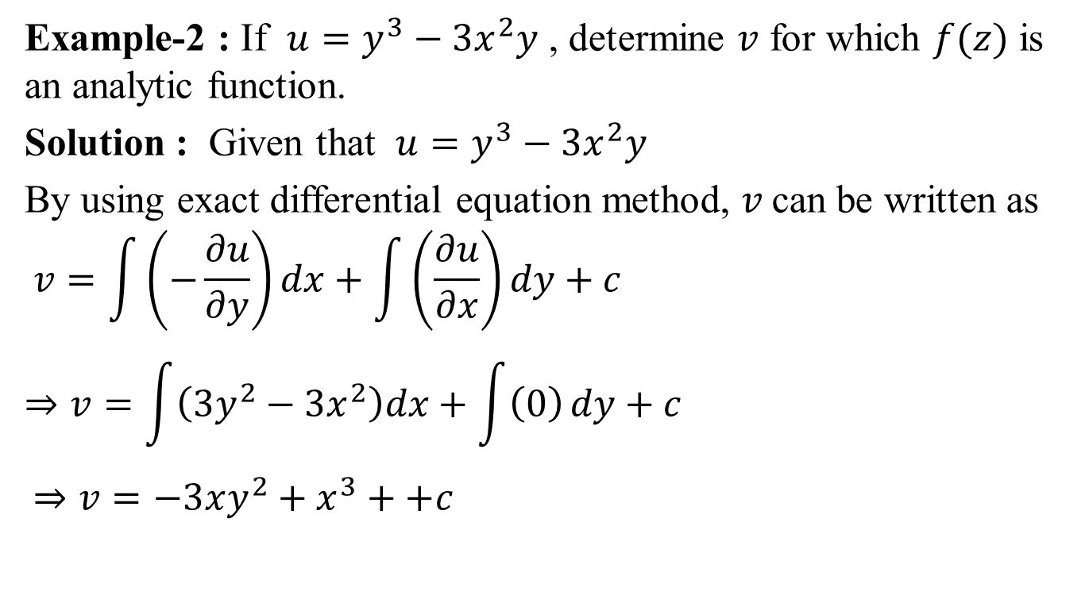
Function of complex variable (CO1)
Example-2 : If $u=y^{3}−3x^{2}y$ , determine $v$ for which $f(z)$ is an analytic function.
Solution : Given that $u=y^{3}−3x^{2}y$
By using exact differential equation method, $v$can be written as
$$v=\int{\left(−\frac{∂u}{∂y}\right)dx+\int{\left(\frac{∂u}{∂x}\right)}dy+c}$$
$$⇒v=\int{\left(3y^{2}−3x^{2}\right)dx+\int{\left(0\right)}dy+c}$$
$$⇒v=−3xy^{2}+x^{3}++c$$

Slide 73
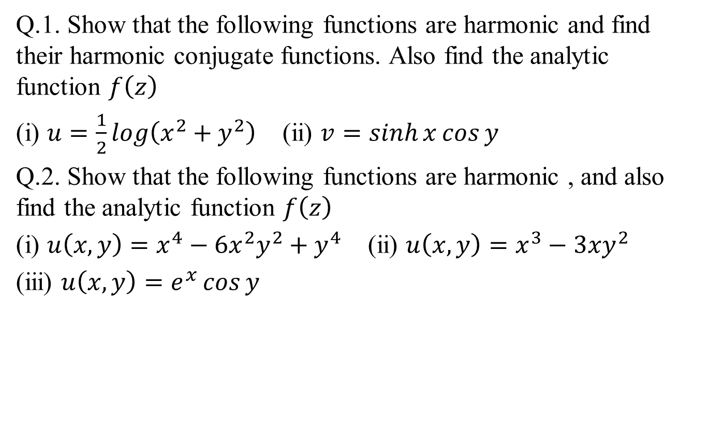
Daily Quiz(CO1)
Q.1. Show that the following functions are harmonic and find their harmonic conjugate functions. Also find the analytic function $f\left(z\right)$
(i) $u=\frac{1}{2}\log\left(x^{2}+y^{2}\right)$ (ii) $v=\sinh{x\cos{y}}$
Q.2. Show that the following functions are harmonic , and also find the analytic function $f\left(z\right)$
(i) $u\left(x,y\right)=x^{4}−6x^{2}y^{2}+y^{4}$ (ii) $u\left(x,y\right)=x^{3}−3xy^{2}$
(iii) $u\left(x,y\right)=e^{x}\cos{y}$

Slide 74
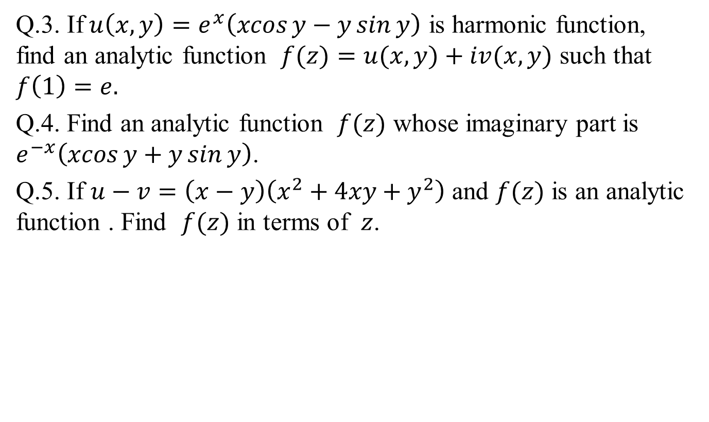
Daily Quiz(CO1)
Q.3. If$u\left(x,y\right)=e^{x}\left(\operatorname{xcos}{y}−y\sin{y}\right)$ is harmonic function, find an analytic function $f(z)=u(x, y)+iv(x, y)$ such that
$$f\left(1\right)=e.$$
Q.4. Find an analytic function $f(z)$ whose imaginary part is $e^{−x}\left(\operatorname{xcos}{y}+y\sin{y}\right)$.
Q.5. If $u−v=\left(x−y\right)\left(x^{2}+4xy+y^{2}\right)$ and $f(z)$ is an analytic function . Find $f(z)$ in terms of $z$.

Slide 75
Recap(CO1)
Complex variables.
Curves and region in complex plane
Limit
Continuity
Differentiability
Analyticity
Harmonic function
Milne’s Thomson Method

Slide 76
Topic objective (CO1)
Conformal mapping can be used in scattering and diffraction problems. For scattering and diffraction problem of plane electromagnetic waves, the mathematical problem involves finding a solution to scaler wave function which satisfies both boundary condition and radiation condition at infinity.

Slide 77

Conformal Mapping (CO1)
Conformal Mapping: Mapping is a mathematical technique used to convert one mathematical problem and its solution into another. It involves the study of complex variables.
Let a complex variable function $z=x+iy$ define in $z$-plane have to convert in another complex variable function $f\left(z\right)=w=u+iv$ define in $w−$plane. This process is called conformal mapping.

Slide 78
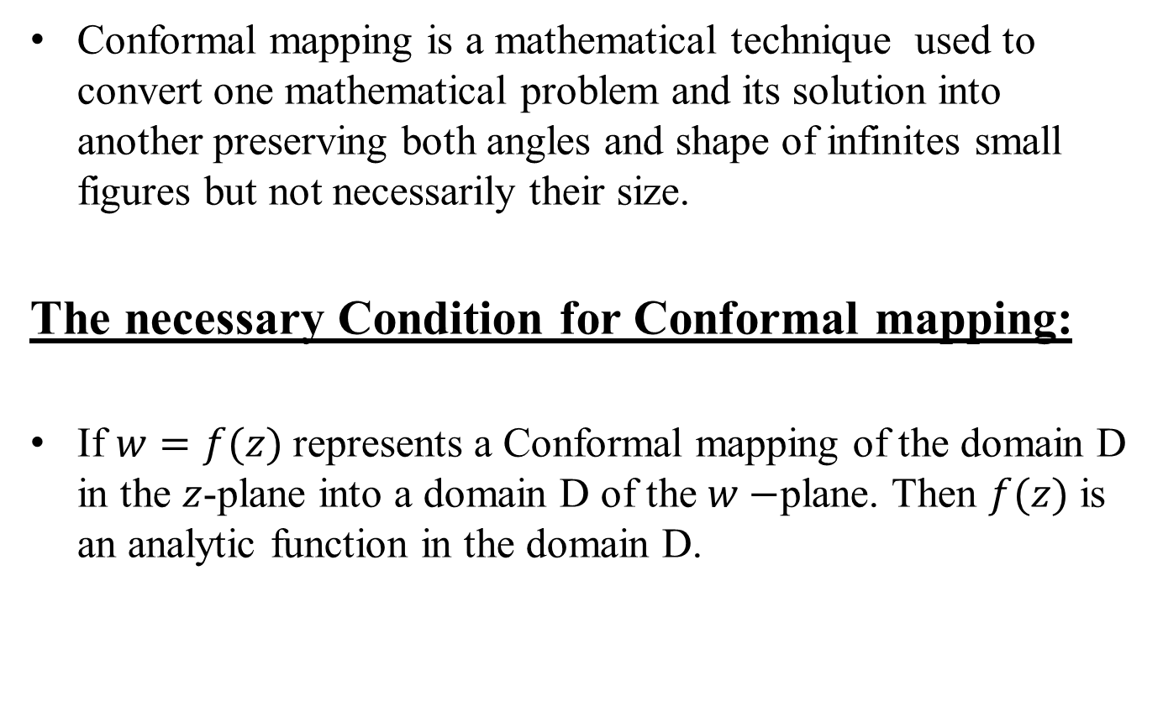
Conformal Mapping (CO1)
Conformal mapping is a mathematical technique used to convert one mathematical problem and its solution into another preserving both angles and shape of infinites small figures but not necessarily their size.
The necessary Condition for Conformal mapping:
If $w=f(z)$ represents a Conformal mapping of the domain D in the $z$-plane into a domain D of the $w−$plane. Then $f(z)$ is an analytic function in the domain D.

Slide 79
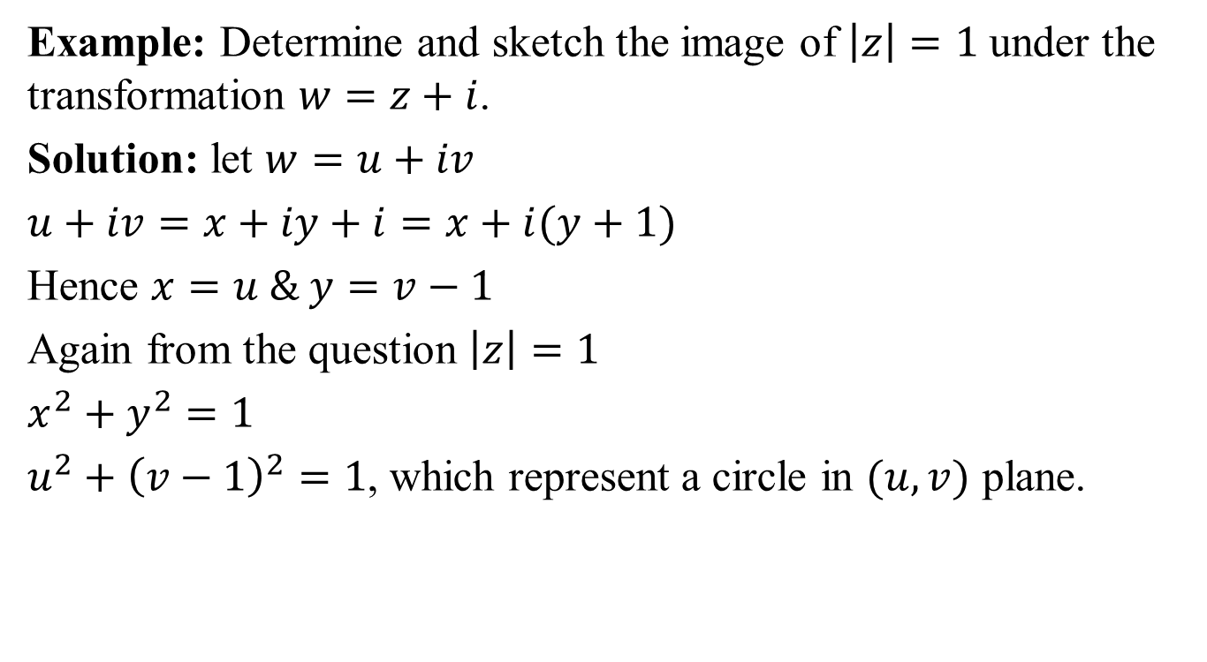
Conformal Mapping(CO1)
Example: Determine and sketch the image of $\left|z\right|=1$ under the transformation $w=z+i$.
Solution: let $w=u+iv$
$u+iv=x+iy+i=x+i(y+1)$
Hence $x=u \& y=v−1$
Again from the question $\left|z\right|=1$
$x^{2}+y^{2}=1$
$u^{2}+{\left(v−1\right)}^{2}=1$, which represent a circle in $(u, v)$ plane.

Slide 80
Conformal Mapping(CO1)

Slide 81
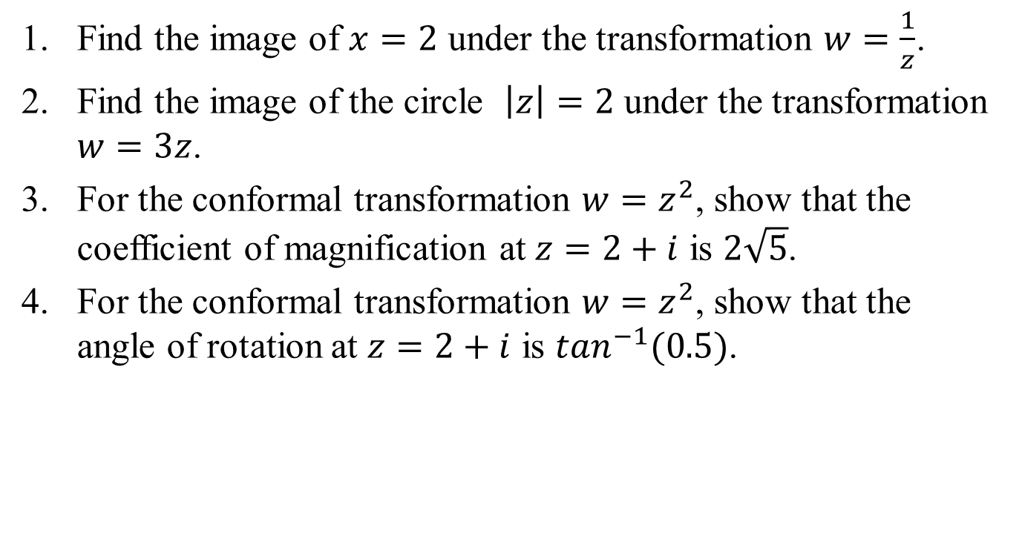
Daily Quiz(CO1)
Find the image of $x=2$ under the transformation $w=\frac{1}{z}$.
Find the image of the circle $\left|z\right|=2$ under the transformation $w=3z$.
For the conformal transformation $w=z^{2}$, show that the coefficient of magnification at $z=2+i$ is $2\sqrt{5}$.
For the conformal transformation $w=z^{2}$, show that the angle of rotation at $z=2+i$ is $\tan^{−1}(0.5)$.

Slide 82
Recap(CO1)
Complex variables.
Curves and region in complex plane
Limit
Continuity
Differentiability
Analyticity
Harmonic function
Milne’s Thomson Method
Conformal Map

Slide 83
Topic objective(CO1)
Bilinear Transformation is used for transforming an analog filter to a digital filter.

Slide 84

Bilinear/Mobius Transformation(CO1)
Bilinear Transformation: A transformation of the form $w=\frac{az+b}{cz+d}$, where $a,b,c,d$ are complex constants and $ad−bc≠0$ is called a bilinear transformation.
Every bilinear transformation $w=\frac{az+b}{cz+d}$, $ad−bc≠0$ is the combination of the basic transformations
Translation: $w=z+c$
Rotation: $w=e^{iα}z$
Magnification: $w=cz$
Inversion: $w=\frac{1}{z}$

Slide 85

Mobius Transformation(CO1)
Cross-ratio:let a set of point $z=\left\{z_{1}, z_{2},z_{3}\right\}$ and its mappings are $w=\left\{w_{1}, w_{2},w_{3}\right\}, then the ratio$
$$\frac{\left(w−w_{1}\right)(w_{2}−w_{3})}{\left(w−w_{3}\right)(w_{2}−w_{1})}=\frac{\left(z−z_{1}\right)(z_{2}−z_{3})}{\left(z−z_{3}\right)(z_{2}−z_{1})}$$
Is called cross- ratio.
Example. Determine the bilinear transformation which maps the points $z=0,−1,i$ onto $w=i, 0, ∞.$ Also, find the image of the unit circle $\left|z\right|=1.$
Solution: The bilinear transformation mapping $z=0,−1,i$ onto $w=i, 0, ∞$ respectively given by
$$\frac{\left(w−w_{1}\right)(w_{2}−w_{3})}{\left(w−w_{3}\right)(w_{2}−w_{1})}=\frac{\left(z−z_{1}\right)(z_{2}−z_{3})}{\left(z−z_{3}\right)(z_{2}−z_{1})}$$

Slide 86

Mobius Transformation(CO1)
$\frac{\left(w−w_{1}\right)\left(\frac{w_{2}}{w_{3}}−1\right)}{\left(\frac{w}{w_{3}}−1\right)(w_{2}−w_{1})}=\frac{\left(z−z_{1}\right)(z_{2}−z_{3})}{\left(z−z_{3}\right)(z_{2}−z_{1})}$
$⇒\frac{(w−i)(−1)}{(−1)(0−i)}=\frac{(z−0)(−1−i)}{(z−i)(−1−0)}$
$⇒\frac{w−i}{−i}=\frac{z(1+i)}{z−i}$
$⇒w−i=\frac{z(−i+1)}{z−i}$
$⇒w=\frac{z(−i+1)}{z−i}+i$
$⇒w=\frac{z+1}{z−i}$ -(1)
Which is the required bilinear transformation.

Slide 87

Mobius Transformation(CO1)
Eqn.(1), can be written as $z=\frac{iw+1}{w−1}$.
Now, $\left|z\right|=1$
$⇒\left|\frac{iw+1}{w−1}\right|=1$
$⇒\left|iw+1\right|=\left|w−1\right|$
$⇒\left|i(u+iv)+1\right|=\left|u+iv−1\right|$
$⇒\left|\left(1−v\right)+iu\right|=\left|(u−1)+iv\right|$
$⇒{\left(1−v\right)}^{2}+u^{2}={\left(u−1\right)}^{2}+v^{2}$
$⇒1+v^{2}−2v+u^{2}=u^{2}+1−2u+v^{2}$
$⇒u−v=0 or v=u$.
Hence the image of unit circle $\left|z\right|=1$ in z-plane is a straight line making an angle $π/4$ to u-axis and passing through origin in w-plane.

Slide 88

Daily Quiz(CO1)
Q1. Find the points of invariant of the transformation $w=\frac{2z+3}{z+2}$.
Q2. Find the fixed points under the transformation $w=\frac{2z−5}{z+4}$.
Q3. Find the bilinear transformations whose fixed points are 1 and 2.

Slide 89

Weekly Assignment(CO1)
Q1. Determine whether $\frac{1}{z}$ is analytic or not .
Q2. Show that the function $e^{x}\left(\cos{y}+i\sin{y}\right)$ is an analytic function , find its derivative.
Q3. Show that $f\left(z\right)=\log{z}$ is analytic everywhere in the complex plane except at the origin and that its derivative is $\frac{1}{z} .$
Q4. Show that the function $f\left(z\right)={\left|z\right|}^{2}$ is continuous everywhere but no where differentiable except at the origin .
Q5. Show that the function defined by $f\left(z\right)=\sqrt{\left|xy\right|}$ satisfy C-R equations at the origin but is not analytic at that point.

Slide 90

Weekly Assignment(CO1)
Q6. Find an analytic function $f(z)$ whose imaginary part is $e^{−x}\left(\operatorname{xcos}{y}+y\sin{y}\right)$
Q7. If $u−v=\left(x−y\right)\left(x^{2}+4xy+y^{2}\right)$ and $f(z)$ is an analytic function . Find $f(z)$ in terms of $z$

Slide 91

Weekly Assignment(CO1)
Q8. Find the image of $x=2$ under the transformation $w=\frac{1}{z}$.
Q9. Find the image of the circle $\left|z\right|=2$ under the transformation
$w=3z$.
Q10. For the conformal transformation $w=z^{2}$, show that the coefficient of magnification at $z=2+i$ is $2\sqrt{5}$.
Q11. For the conformal transformation $w=z^{2}$, show that the angle of rotation at $z=2+i$ is $\tan^{−1}(0.5)$.
Q12. Find the points of invariant of the transformation $w=\frac{2z+3}{z+2}$.
Q13. Find the fixed points under the transformation $w=\frac{2z−5}{z+4}$.
Q14. Find the bilinear transformations whose fixed points are 1 and 2.

Slide 92

Faculty Video Links, Youtube & NPTEL Video Links and Online Courses Details(CO1)
Video Links:
https://www.youtube.com/playlist?list=PLzJaFd3A7DZuyLLbmVpb9e9V3Q9cYBL
https://www.youtube.com/playlist?list=PLbMVogVj5nJS_i8vfVWJG16mPcoEKMuWT
https://youtu.be/b5VUnapu-qs
https://youtu.be/b5VUnapu-qs
https://youtu.be/yV_v6zxADgY
https://youtu.be/2ZBcbFhrfOg
https://youtu.be/dlK0E0OG39k
https://youtu.be/qjpLIlVo_6E

Slide 93

MCQ’s(CO1)
1. $\lim_{z→0}{\frac{z}{\overline{z}}}$
Limit exists
Limit does not exist
Limit exists and equal to 1
None of these
2. If $f\left(z\right)=\frac{z}{z^{2}+9}$ then
$f(z)$ is continuous
$f(z)$ is discontinuous at $z=±3i$
$\lim_{z→i}{\frac{z}{z^{2}+9}=−\frac{i}{8}}$
Both B & C

Slide 94

MCQ’s(CO1)
3. Analytic function is also known as
Regular function
Holomorphic function
Both A & B
None of these
4. The harmonic conjugate of the function $u=x^{2}−y^{2}−y$ is
$−4xy + y$
$2xy + y$
$2xy +x$
None of these

Slide 95

Glossary Questions(CO1)
Pick the correct option from glossary:
$f\left(z\right)=\frac{1}{z}$
$f\left(z\right)=\cos{z}$
$f\left(z\right)=logz$
$f\left(z\right)=e^{iz}$
Is analytic in entire complex plane except origin
Is analytic in entire complex plane
$f^{′}\left(z\right)=\frac{1}{z}$
Has imaginary part $e^{−y}\sin{x}$

Slide 96

Glossary Questions(CO1)
2. Pick the correct option from glossary:
$u\left(x,y\right)=x^{2}+y^{2}$
$u(x,y)=2x(1−y)$
(iii) $v\left(x,y\right)=e^{x}$
$v(x,y)=2xy$
$u(x,y)$ is not harmonic function
$u(x,y)$ is harmonic function
$v(x,y)$ is not harmonic function
$v(x,y)$ is harmonic function

Slide 97
First Sessional Paper

Slide 98

First Sessional Paper

Slide 99

First Sessional Paper

Slide 100

First Sessional Paper

Slide 101
Second Sessional Paper

Slide 102
Second Sessional Paper

Slide 103
Second Sessional Paper

Slide 104
Second Sessional Paper

Slide 105
Third Sessional Paper

Slide 106
Third Sessional Paper

Slide 107
Third Sessional Paper

Slide 108
Third Sessional Paper

Slide 109

Expected Questions (CO1)
Q1. If $f(z)$is a regular function of z, prove that $\left(\frac{∂^{2}}{∂x^{2}}+\frac{∂^{2}}{∂y^{2}}\right){\left|f(z)\right|}^{2}={4\left|f^{′}(z)\right|}^{2}$.
Q2. If $u−v=\left(x−y\right)\left(x^{2}+4xy+y^{2}\right)$ and $f(z)$ is an analytic function . Find $f(z)$ in terms of $z$.
Q3. Find the bilinear transformation which maps the points$z=0,1,∞$ into the points $w= i,−1,−i$ respectively.
Q4. Consider the transformation $z=\sqrt{2}e^{\frac{iπ}{4}} z$ and determine the region $R’$ of $w$ –plane corresponding to rectangular region $R$ bounded by the lines $x=0, y=0 , x=2$ and $y=1$ in $z$-plane.

Slide 110
Recap of Unit
Functions of complex variable
Limit, Continuity and differentiability
Analytic functions
Cauchy- Riemann equations (Cartesian and Polar form),
Harmonic function
Method to find Analytic functions
Conformal mapping
Mobius transformation and their properties.

Slide 111

References
Text Books
Erwin Kreyszig, Advanced Engineering Mathematics, 9thEdition, John Wiley & Sons, 2006.
P. G. Hoel, S. C. Port and C. J. Stone, Introduction to Probability Theory, Universal Book Stall, 2003(Reprint).
S. Ross: A First Course in Probability, 6th Ed., Pearson Education India, 2002.
W. Feller, An Introduction to Probability Theory and its Applications, Vol. 1, 3rd Ed., Wiley, 1968.

Slide 112
References
R.K. Jain and S.R.K. Iyenger: Advance Engineering Mathematics; Narosa Publishing House, New Delhi.
B.S. Grewal, Higher Engineering Mathematics, Khanna Publishers, 35th Edition, 2000. 2.T.Veerarajan : Engineering Mathematics (for semester III), Tata McGraw-Hill, New Delhi.
J.N. Kapur: Mathematical Statistics; S. Chand & Sons Company Limited, New Delhi.
D.N.Elhance,V. Elhance & B.M. Aggarwal: Fundamentals of Statistics; Kitab Mahal Distributers, New Delhi.

Slide 113
Thank You

